Slide 1
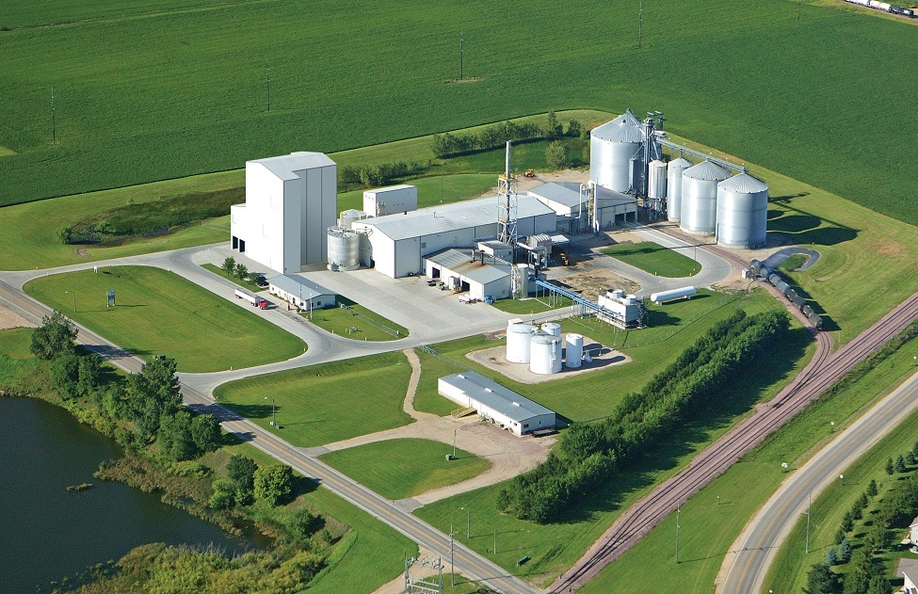
EKC 464 BIOREFINERY ENGINEERING
Nur Ayshah Rosli, PhD
Room No: 2.22
Ext: 6487

Slide 2
Separation and purification technologies in biorefinery.

Slide 3
Learning outcome
Be able to understand separation and purification technologies in biorefinery

Slide 4
Reference
Separation and purification technologies in biorefineries. Ramaswamy, S., Huang, H. J., & Ramarao, B. V. (2013). John Wiley & Sons Incorporated.
Biorefineries and Chemical Processes: Design, Integration and Sustainability Analysis - Author(s): Jhuma Sadhukhan Kok Siew Ng Elias Martinez Hernandez.

Slide 5
Equilibrium-based separation techniques: Distillation, liquid-liquid extraction and supercritical extraction
Affinity-based separation techniques: Adsorption, ion exchange and simulated moving-bed technology for biorefinery applications
Membrane separation
Solid-liquid separation
Hybrid/integrated reaction-separation systems: Process intensification

Slide 6
Introduction
Separation is simply the process of dividing material into its component parts.
Separation techniques are essentially methods of purification.
Homogeneous and heterogeneous mixtures can be separated into their components by several physical methods.
The choice of separation techniques is based on the type of mixture and difference in the chemical properties of the constituents of a mixture.

Slide 7
CLASSIFICATION OF SEPARATION PROCESS
Based on the nature or physical mechanism of separation, various separation processes can be classified into;
1) Mechanical separations: separations based on size and/or density differences of different components in a mixture, for separation of solid from liquid (e.g. filtration and centrifugation).
2) Diffusional separations (mass transfer operations): separations based on molecular movement toward a favorable phase, for separation of dissolved components (e.g. distillation, absorption, extraction). (“Mass transfer is the transfer of solute molecules from one point to anther or from one phase to another.”
3) Membrane separations: use of a semipermeable membrane to separate molecules with difference in size or some other properties.

Slide 8
VARIOUS TYPES OF SEPARATION PROCESSES
Separating Funnel
Centrifugation
Evaporation
Crystallization
Magnetic separation
Filtration
Sedimentation
Distillation
Membrane Separations
Chromatography

Slide 9
Equilibrium-based separation techniques: Distillation, liquid-liquid extraction and supercritical extraction

Slide 10
Distillation
*Zhang, X. S., Yang, G. X., Jiang, H., Liu, W. J., & Ding, H. S. (2013). Mass production of chemicals from biomass-derived oil by directly atmospheric distillation coupled with co-pyrolysis. Scientific reports, 3, 1120.

Slide 11
*DDGS - Distiller's dried grains with solubles

Slide 12
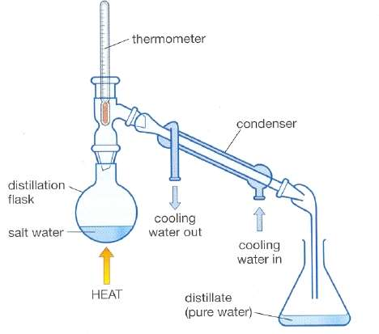
Distillation is a process of separating the component or substances from a liquid mixture by selective evaporation and Condensation.
The application of distillation can roughly be divided in two groups: laboratory scale, industrial distillation.
The main difference between laboratory scale distillation and industrial distillation is that laboratory scale distillation is often performed batch-wise, whereas industrial distillation often occurs continuously.

Slide 13
Two prerequisites must be satisfied simultaneously to ensure that distillation can take place:
the relative volatility as a driving force
the separation equipment.

Slide 14
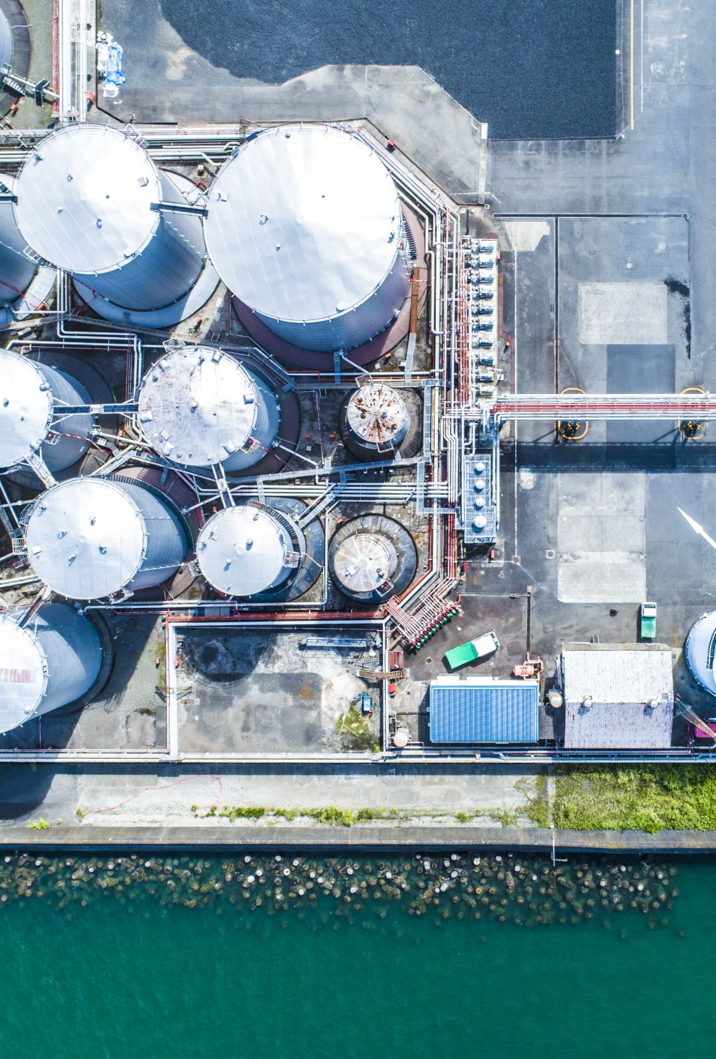
Type of distillation in biorefinery
Ordinary distillation
Azeotropic distillation
Extractive distillation
Molecular distillation
Atmospheric distillation

Slide 15
AZEOTROPIC DISTILLATION
Principle
Addition of new substance to the liquid mixture in order to increase relative volatility of one of two components and make separation easier.
Example: Benzene is added to mixture of water and EtOH

Slide 16
This occurs because, when an azeotrope is boiled, the resulting vapor has the same ratio of constituents as the original mixture.
Because their composition is unchanged by distillation, azeotropes are also called constant boiling mixtures.
Positive azeotrope is 95.63% ethanol and 4.37% water (by weight).
Ethanol boils at 78.4°C, water boils at 100°C, but the azeotrope boils at 78.2°C.
Negative azeotrope is hydrochloric acid at a concentration of 20.2% and 79.8% water (by weight). Hydrogen chloride boils at −84°C and water at 100°C, but the azeotrope boils at 110°C.

Slide 17
Azeotropic distillation usually refers to the specific technique of adding another component to generate a new, lower-boiling azeotrope that is heterogeneous (e.g. producing two, immiscible liquid phases), such as the example below with the addition of benzene to water and ethanol.

Slide 18
Example - distillation of ethanol/water, using normal distillation techniques, ethanol can only be purified to approximately 96% .
Some uses require a higher percentage of alcohol, eg. when used as a gasoline additive.
Material separation agent- The addition of a Material Separation Agent, such as benzene.
Molecular sieves- For the distillation of ethanol for gasoline addition, the most common means of breaking the azeotrope is the use of molecular sieves.

Slide 19
Examples of applications of azeotropic distillation in biorefineries

Slide 20
Extractive distillation
Extractive distillation is defined as distillation in the presence of a miscible, high boiling, relatively non- volatile component, the solvent, that forms no azeotrope with the other components in the mixture.
When third substance added to azeotropic mixture is non-volatile.
Suitable for the separation of hydrocarbons with close boiling points and mixtures forming azeotropes
Example - Glycerin addition to reduce vapor pressure of water
The method of extractive distillation uses a separation solvent, which is generally nonvolatile, has a high boiling point and is miscible with the mixture, but doesn't form an azeotropic mixture.
The solvent interacts differently with the components of the mixture thereby causing their relative volatilities to change.

Slide 21
Solvent selection for extractive distillation
The solvent must alter the relative volatility by a wide enough margin for a successful result. The quantity, cost and availability of the solvent should be considered.
The solvent should be easily separable from the bottom product, and should not react chemically with the components or the mixture, or cause corrosion in the equipment.
A classic example is of aniline as suitable solvent.

Slide 22
Flowsheet for the separation of ethanol and water with extractive distillation with solid salt

Slide 23
Two column process for the separation of ethanol and water with extractive distillation with liquid solvent

Slide 24
Types of separating agents
Liquid solvents
Solid salts (or dissolved salts)
Mixture of liquid solvent and solid salt
Ionic liquids
Hyperbranched polymers

Slide 25
What is ionic liquids (IL)?
Typical ionic liquids are composed of a large organic cation and an inorganic polyatomic anion.
Liquid state at ambient temperature.
Have the advantages of both liquid solvents (easy operation) and solid salts (high separation ability).
IL do not pollute the top product of the extractive distillation column and thus can be applied to separation and purification in biorefineries, pharmaceutics and food processing, and so forth.
In this regard, they are “green” solvents.

Slide 26
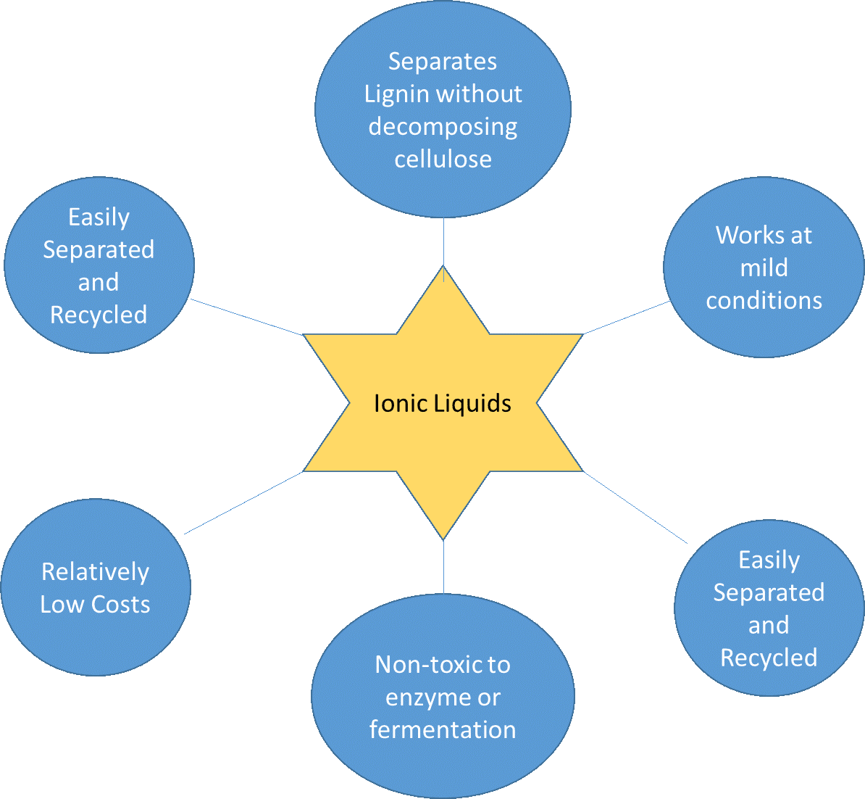

Slide 27
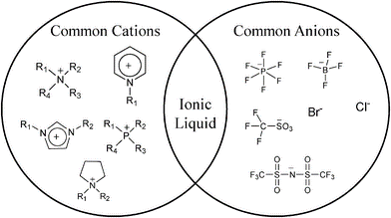
Example in biorefineries
Production of anhydrous ethanol
Example of IL - 1-alkylpyridinium chloride (dissolve cellulose)
IL can disrupt the intermolecular forces that hold agglomerated biopolymers together.

Slide 28
Molecular distillation
Molecular distillation is generally accepted as the safest method to separate and purify thermally unstable compounds and substances having low volatility with high boiling points; heat-sensitive compounds.
Features of molecular distillation;
short residence time in the zone of the molecular evaporator exposed to heat;
low operating temperature due to high vacuum in the space of distillation
characteristic mechanism of mass transfer in the gap between the evaporating and condensing surfaces

Slide 29
The separation principle of molecular distillation is based on the difference of molecular mean free path.
The passage of the molecules through the distillation space should be collision free.

Slide 30
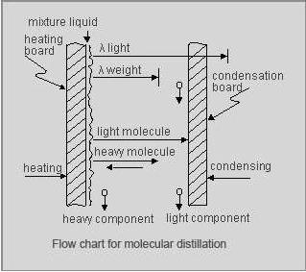

Slide 31
The reason why molecular distillation is not widely applied as a special distillation process for separating the common mixture with close boiling point or forming azeotrope may be:
limited theoretical stages, when compared with other special distillation columns;
low production scale, but high energy consumption per amount of product;
complicated equipment and high investment cost in order to achieve a high vacuum degree.

Slide 32
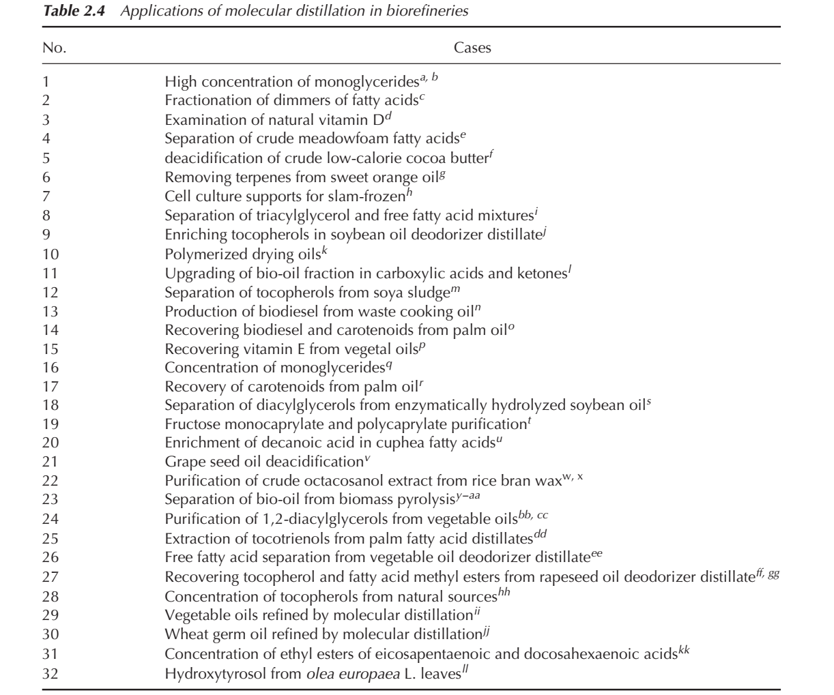

Slide 33
Challenge in distillation process in industry
energy intensive nature
negative environmental impact
complicated operation procedure
conventional distillation process is inadequate for small-scale operations, particularly in the presence of azeotropic mixtures.

Slide 34
Equilibrium-based separation techniques: Distillation, liquid-liquid extraction and supercritical extraction

Slide 35
Liquid-liquid extraction
Liquid-liquid extraction (LLE), also known as solvent extraction, is a typical ternary system in the chemical engineering field, which separates chemicals from one solution to another based on the different solubility of the solute chemical in two solvents.
Three components are involved in the LLE process: solute, diluent, and extractant.
Solute, which is dissolved in diluent, is extracted from the diluent and dissolved into another solvent, the extractant.

Slide 36
EXTRACT
SOLVENT
FEED
RAFFINATE
Feed – the solution which is to be extracted
Solvent – the liquid with which the feed is contacted
Extract – The solvent-rich product
Raffinate – residual liquid which solutes has been removed.

Slide 37
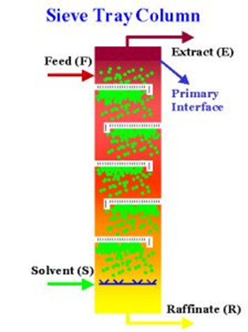

Slide 38
Why not distillation?
LLE is used when the required solute to extract from the feed has almost similar boiling point with the carrier.
Distillation process has higher operating cost because used of heating process in distillation.

Slide 39
The requirements for Extractants
Have specific selectivity for the solute so that most of desirable solute can be dissolved in the extractant from the diluent, and vice versa for undesirable compounds
The solute should be easily separated from extractant after the LLE
High partition ratio allowing effective separation of a desirable compound from the diluent
High solubility for the target solute and low solubility for the diluent
Have different density from diluents for easy layering;
High interfacial tension for rapid coalescence for extractant droplets after agitation
Low toxicity for the extractant and diluents is needed for industrial use.

Slide 40
Drawback of LLE
Emulsion formation
Large volumes of toxic organic solvents
Time-consuming process – e.g tiny density difference between two immiscible phases

Slide 41
Fundamental principles of LLE
Equilibrium partition ratios
In the ideal equilibrium state, the solute concentration is low enough that every solute molecule is surrounded by solution and the two phases of the dissolved solute are in the same molecular state;
Therefore, the weight fraction of solute in extractant (y) divided by the weight fraction of solute in the diluent (x) at the given stable condition is constant, termed partition ratio (K)
$$K=\frac{y}{x}$$

Slide 42
Distribution coefficient
The solute will be at different states in different phases, and different states of solute will exchange depending on the solution.
Therefore, the partition ratio is not a constant—it will change as the extractant changes.
The distribution coefficient is introduced to describe the ratio of solute concentration in extractant to that in diluents
$$A=\frac{S_{e}}{S_{d}}$$
$S_{e}$ : solute concentration in extractant (mol/L)
$S_{d}$ : solute concentration in diluent (mol/L)

Slide 43
Separation factor
The separation factor is a dimensionless factor that measures the relative enrichment of solute in extractant after the LLE process.
For a given separation process, several solutes are in diluents.
The desirable and unwanted solutes need to be separated by LLE.
$$S_{f}=\frac{\left(S_{e}/R_{e}\right)}{\left(S_{d}/R_{d}\right)}$$
$S_{f}$ : separation factor;
$S_{e}$ : desirable solute in extractant;
$R_{e}$ : unwanted solute in extractant;
$S_{d}$ : desirable solute in diluent; $R_{d}$ : unwanted solute in diluent.

Slide 44
Extraction factor
$$Extraction factor= \frac{total amount of solute in extractant phase}{total amount of solute in raffinate phase}$$
Extraction factor related to the volume of extractant used in the system.
For many commercial processes, the extraction factor is in the range of 1.3 to 5.
The extraction factor depends on the operation factors, such as temperature, solution volume, and concentration of salt in solution

Slide 45
Phase diagrams (two phases)
Illustrate the ternary liquid-liquid equilibrium
Each axis in the triangle can represent mass percentage, volume percentage, or molecular percentage of each component in the LLE process.
The triangle phase diagram of the system with three components

Slide 46
Categories in LLE Design
Standard extraction
Fraction extraction
Dissociative extraction
Reaction-enhanced extraction
Hybrid extraction processes.

Slide 47
Standard extraction
This extraction is the most basic and simple design of LLE.
The extractant is mixed with diluents in a single stage, multiple stages, or continually at countercurrent flow direction
In most cases, extractant and diluent are fed into mixture vessel continually, and then the LLE is followed by evaporation to recycle the extractant. The continuous standard extraction process can extract solutes from diluents step by step, resulting in nearly complete extraction.
Contaminants are a challenge for this simple process, as they transfer into extractant from diluents together with solute.
To avoid unwanted chemicals, it is recommended that the ratio of Ki/Kj of solvents, should reach at least 20:1, depending on the solute and contaminant concentration in diluents.

Slide 48
Fraction extraction
Dual solvent extraction - modified by adding a washing step
High recovery of solute and the low amount of contaminant transferred during the process
Can be applied to the system with the separation factor as low as 4

Slide 49
Dissociative extraction
Dissociative extraction is usually applied to the chemical solute with weak organic acids or bases in its solution.
The solubility of solute with a neutral state in organic solvent is higher than that of one with a charged state condition.
A charged solute has higher solubility in aqueous solution than in organic solution.
The concept of dissociative extraction is explored in other chemical separations such as the separation of antibiotics by pH-shift extraction, which means that a solute transfers from one solution to another by pH changes.

Slide 50
Reaction-enhanced extraction
To change the solubility of a solute, some solute is used to react with an agent to obtain high solubility in an extractant.
In most cases, the extractive reaction happens in the presence of the diluents and extractant.
The modified solute is obtained as well as the solute that was dissolved into extractant.
At the same time, low solute concentration in the diluents helps the extractive reaction to modify solute formation.

Slide 51
Hybrid extraction processes
These processes include any combination of extraction processes for extraction improvement, such as extraction-separation, reverse osmosis, and extraction.
These combinations are based on specific products so it is difficult to describe all the combinations used industrially and in laboratories.

Slide 52
Criteria of efficient liquid-liquid extractors in biorefineries
High volumetric efficiency
Avoiding surface-active impurities
Production capacity
Flexibility and the ease of scaling up
Tolerance for fouling, and ease of cleaning
Easy operation
The availability of the extractor

Slide 53
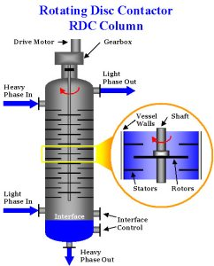
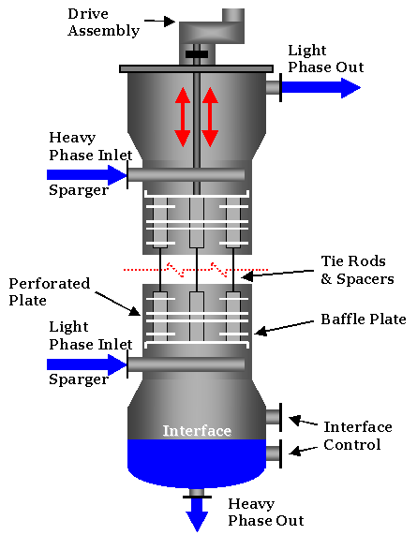
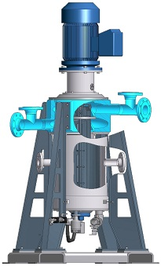
Type of extractors
Static extraction column
Agitated column
Centrifugal extractor

Slide 54
Example of packing types in LLE:

Slide 55
Application of LLE in biorefineries
Lignocellulosic ethanol production.
Biodiesel production
Recovery of carboxylic acids
Hydrocarbon production from microbial species

Slide 56
Bioethanol production from lignocellulose typically comprises four major steps: (1) a pretreatment step to make polysaccharides more accessible, (2) an enzymatic hydrolysis process to break down polysaccharides to simple sugars, (3) a fermentation step where a microorganism ferments sugars into ethanol, and (4) a separation stage to obtain fuel grade ethanol.

Slide 57
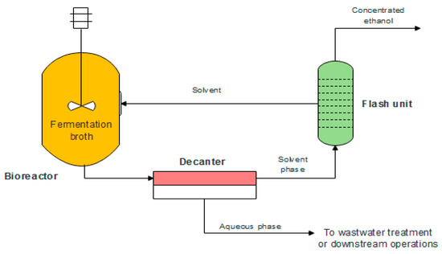
Fermentation and purification are the major steps during bioethanol production.
Ethanol and total water are the major components of the broth after alcoholic fermentation.
Thus, separation is needed to purify the bioethanol from the fermentation broth.

Slide 58
Challenges in separating ethanol from fermentation broth using LLE
A yeast layer will build at the interface due to cells will be attracted to the liquid-liquid interface; which create a mass transfer barrier to reduce the rate of ethanol extraction

Slide 60
Equilibrium-based separation techniques: Distillation, liquid-liquid extraction and supercritical extraction

Slide 61
Supercritical fluid as a solvent
Solvent are used in large amount in chemicals, pharmaceutical, food and natural products industry
In search of environmentally friendly solvent, attention has been paid to supercritical fluid for wide application in extraction, chromatograhy, particle design, reaction, drying etc.

Slide 62
What is supercritical fluid?
A supercritical fluid is a solvent at a temperature that is above its critical point, condition at which the fluid remains in a single phase, regardless the pressure.

Slide 63
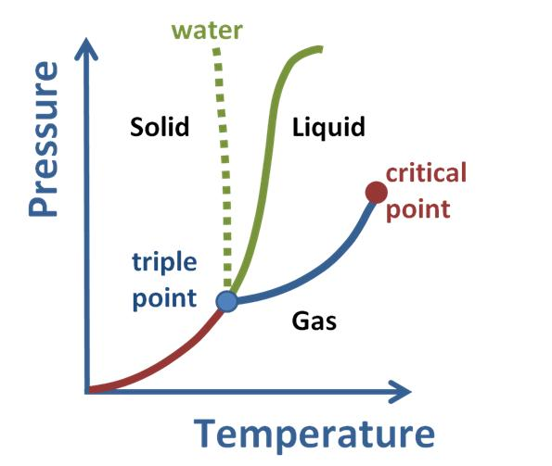
Supercritical fluids have properties between those of a gas and a liquid
A supercritical fluid can effuse through solids like a gas and dissolve materials like a liquid.
All supercritical fluids are completely miscible with each other, so for a mixture a single phase can be guaranteed, if the critical point of the mixture is exceeded..

Slide 64
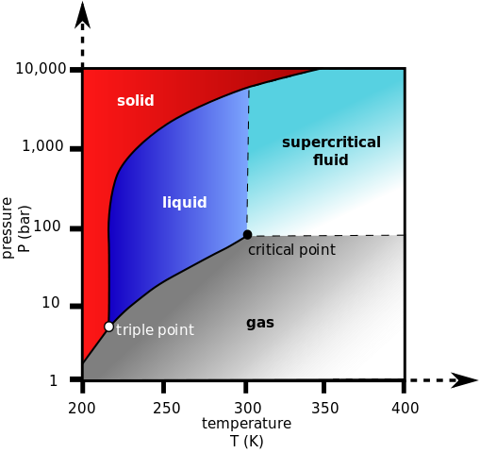
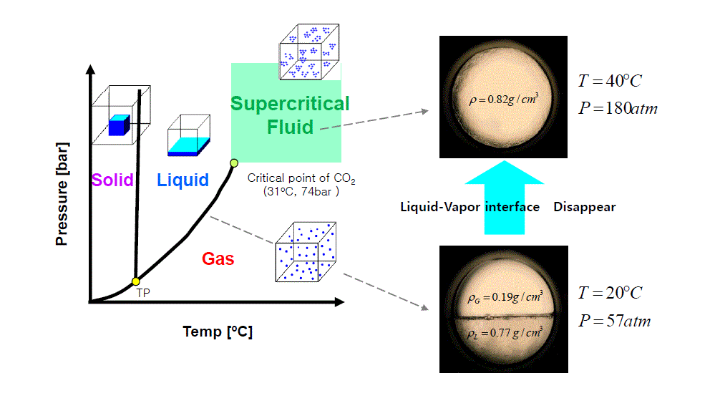
Phase Diagram for Carbon Dioxide indicates the supercritical fluid region of CO₂.

Slide 65
Advantage of SCF
Lower operating temperatures
Improved yield
Improved product properties
Favourable combination of process steps
Easier regeneration of the supercritical solvents
No liquid solvent
Lower production cost
Example of common SCF – water, CO2,

Slide 66
CO₂ – the most widely used SCF
Low critical parameters (73.8 bar and 31.1 deg C)
GRAS
Non-toxic, non-flammable, non-explosive
Odourless and tasteless
Environmentally friendly
Cheaper and widely available
Easily removed, no residue issue
completely miscible with hydrocarbons of low molecular weight and oxygenated organic compounds

Slide 67
Supercritical fluid extraction
Supercritical fluid extraction (SFE) is the process of separating one component (the extractant) from another (the matrix) using supercritical fluids as the extracting solvent.
From the point of view of green chemistry, extraction processes would need to use natural solvents, which include water, ethanol and carbon dioxide.

Slide 69
Extraction of solutes from a solid matrix occurs in five basic stages that can occur in series/parallel
The solvent is placed in contact with the surface of the solid matrix. • Intraparticular solvent diffusion occurs as the solvent accesses the interior of the matrix. The separation process begins in this way. • The retained solutes are moved by simple drag or displacement from the active sites of the matrix due to the higher affinity and/or concentration of solvent molecules. Solubilization (solvation) occurs immediately in the solvent. • Solutes are transported from inside the matrix to its surface, essentially by diffusion, which is the most important mechanism of transport at this stage. • The dissolved solutes cross through the interstitial film fluid that surrounds the solid and they are transported to the bulk solvent and removed from the bed of solid particles.

Slide 70
Important parameters to consider for SFE
Pressure - higher pressure results in higher CO₂ density, thereby leading to better solubility of desired compound
Temperature - Suitable extraction temperature of thermolabile compounds to avoid degradation and impurity problems.
selection of co-solvent – addition of ethanol, but the selectivity might be lower than that of using pure CO₂.
Duration of extraction - longer processing times may improve extraction efficiency.
Co-solvent concentration - When the co-solvent concentration is too high, the density of SC-CO₂ will decrease, causing lower extraction efficiency

Slide 71
Advantage of SC technology in biorefineries
Consumers tend to demand products made from clean technology, with liquid organic solvents replaced with solvents such as carbon dioxide.
Products extracted with supercritical fluids are of higher quality than those obtained by extraction with organic solvents, mainly because of the absence of waste solvent residues in the products, but also because the materials are processed at moderate temperatures so that their properties are not altered.
There is no need for the separation of the solvent from the extract
Supercritical processes allow environmental problems to be solved, such as the reduction of emissions of volatile organic compounds and the replacement of conventional halogenated solvents used in wool, paints and metal, and textile drying and cleaning
The rapid rate of SFE processes in comparison to classical separations makes operation times far lower

Slide 72
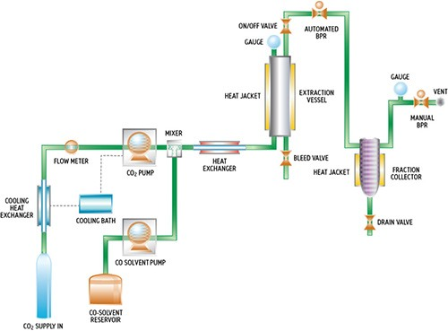
SFE Setup

Slide 73
Specific example in biorefineries
Sugar/starch as a raw material
Supercritical extraction of vegetable oil
Supercritical extraction of lignocellulose biomass
Supercritical extraction of microalgae

Slide 74
Sugar/starch as a raw material
After the fermentation of sugars it is necessary to separate ethanol from the aqueous solution.

Slide 75
Supercritical extraction of vegetable oil
Supercritical fluid extraction has proven to be effective in the separation of essential oils and their derivatives for use in the food, cosmetics, pharmaceutical and other related industries
In the production of biodiesel in a biorefinery, SFE can be an interesting technique for the extraction step before the transesterification process.

Slide 76
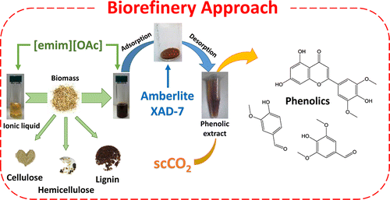
Supercritical extraction of lignocellulose biomass
CO₂ at 140 bar and 35°C presents physicochemical properties that are useful for the extraction of vanillin, vanillin derivatives (vanillic acid), and other compounds with similar chemical structure (phydroxybenzaldehyde, syringaldehyde, p-coumaric acid).
*[emim][OAc] is 1-ethyl-3-methylimidazolium acetate
Ref: da Costa Lopes, A. M., Brenner, M., Falé, P., Roseiro, L. B., & Bogel-Łukasik, R. (2016). Extraction and purification of phenolic compounds from lignocellulosic biomass assisted by ionic liquid, polymeric resins, and supercritical CO2. ACS Sustainable Chemistry & Engineering, 4(6), 3357-3367.

Slide 77
Supercritical extraction of microalgae
The autotrophic cultivation potentials of microalgae for biofuels production, lipid extraction, long chain fatty acids (such as docosahexaenoic acid (DHA) and eicosapentaenoic acid (EPA)) and pigments (such as astaxanthin and lutein).
For microalgae samples, the water content is usually high. Thus, a drying step is usually required prior to extraction.
One of the important characteristics of microalgae is the rigidity of its cell wall, while damage to the cell wall (mechanical cell disruption methods) allows more SC-CO₂ to reach the target components.
However, higher cost needed and difficult to scale up the process.

Slide 78
Up-grade of Bio-oil using SCF
Bio-oil as such can not be used as transportation fuel as it contains high percentage of water (~ 45 wt %).
Also, water decreases its calorific value,
It forms azeotrope with organic compounds,
It increases percentage of oxygen and results in polymerization at room temperature in few weeks.
Methods for removal of water: Solvent extraction Supercritical CO₂ extraction (Green process)

Slide 80
Drawback of SFE Technology
Potential extreme corrosion problems (scW)
Reactors made of exotic alloys
Energy intensive
Must be run as batch process
Cannot be used with high MW substances
Thermal degradation
scW cannot be used in pharmaceuticals
higher equipment costs required compared to the traditional solvent extraction process.

