Slide 1
BIOREFINERY SYSTEM
Fischer–Tropsch liquid and methanol synthesis
Algae biorefineries
Value-added chemicals (term paper)
By: Nur Ayshah Rosli, PhD

Slide 2
Fischer–Tropsch liquid and methanol synthesis

Slide 3
FT reaction was discovered in 1923 by
Franz Fischer, Hans Tropsch, and Helmut Pichler, at Kaiser Wilhelm Institute when they reacted synthesis gas over cobalt catalyst, resulting in production of gasoline, diesel, middle and heavy distillate oils.
In 1923, where did they get the syn-gas from?

Slide 4
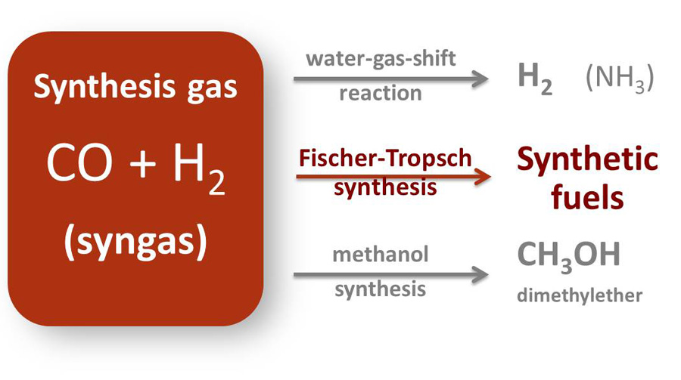

Slide 6
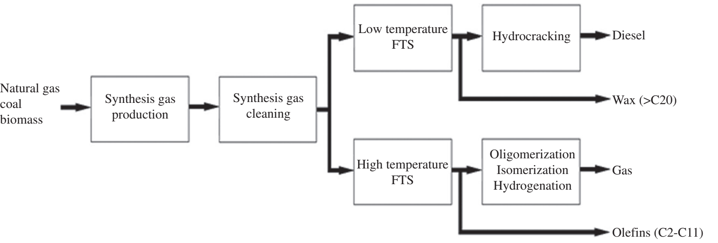

Slide 7
Fischer Tropsch Process
Input Materials
Coal
Natural Gas
Biomass
Process Chemistry:
Temperature: 150-300°C
$$\left(2n+1\right)H_{2}+nCO→C_{n}H_{(2n+2)}+nH_{2}O$$

Slide 8
Fischer – Tropsch Process

Slide 9
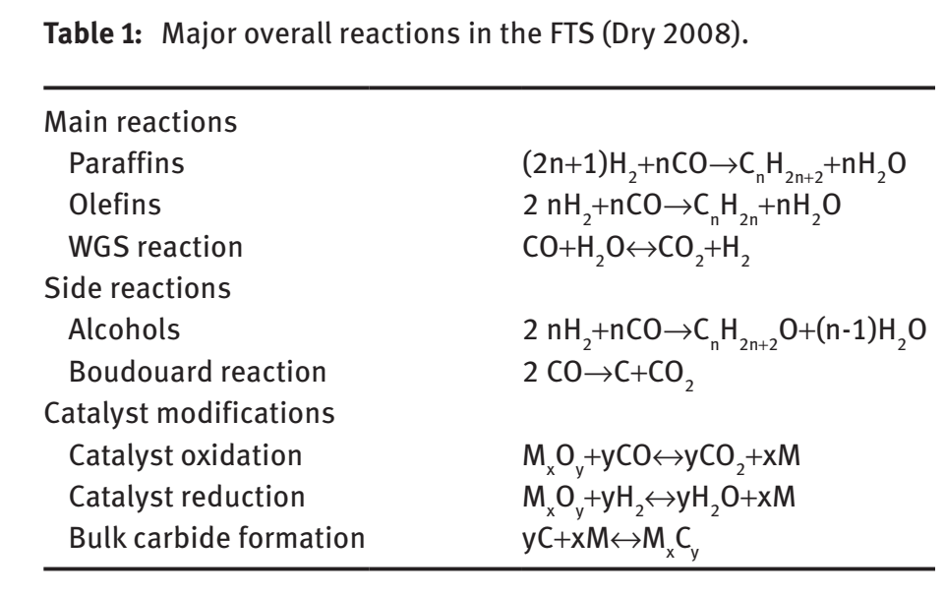

Slide 10
Type of FT reactors
Circulating fluidized bed reactor
Fixed fluidized bed reactor
Tubular fixed bed reactor
Slurry phase reactor

Slide 11
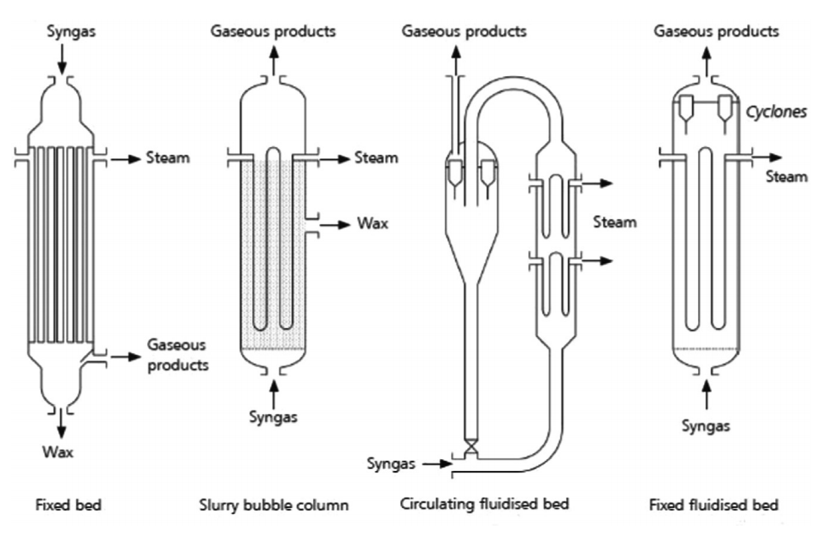

Slide 12
Classification of FT reactors
Class of FT reactors | High Temperature Fischer-Tropsch (HTFT) | Low Temperature Fischer-Tropsch (LTFT)
Operating Temperature | 320-350˚C | 220-250˚C
Operating Pressure | 2 MPa | 2 MPa
Type of reactor | circulating fluidized bed, bubbling fluidized bed | tubular fixed bed, and slurry phase reactor
Catalyst | Cobalt, iron catalyst | precipitated iron catalysts or supported cobalt catalysts
Main products | olefins | longer chain hydrocarbon

Slide 13
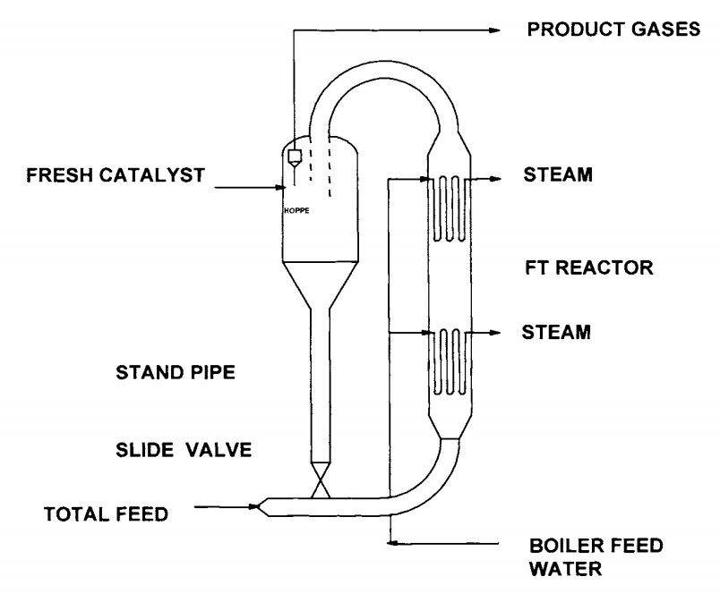
HTFT – circulating fluidized bed reactor

Slide 14
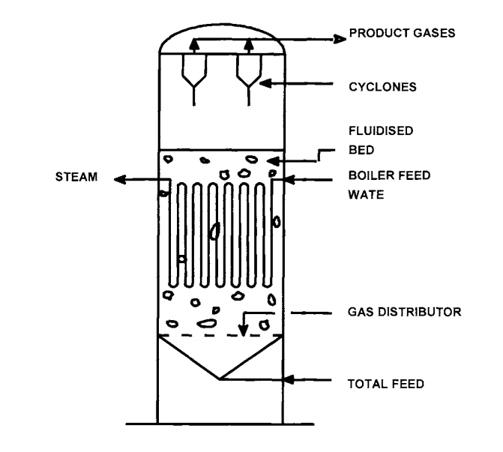
HTFT – fixed fluidized bed reactor

Slide 15
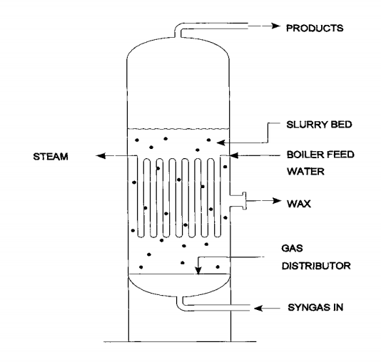
LTFT - Slurry Phase Reactor

Slide 16
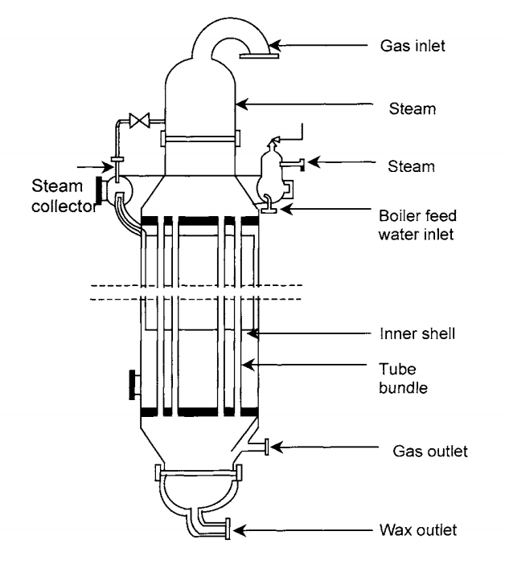
LTFT – Multitubular fixed bed reactor

Slide 17
FT process challenges
Heat removal from the process
Syngas Clean-Up
Catalyst deactivation rate
Change in feedstock

Slide 18
Catalyst
Transition Metal
Cobalt
Highly active
Feedstock is natural gas
Iron
Suitable for low-hydrogen-content synthesis gases
Lower quality feedstock, coal or biomass
Ruthenium
Very Expensive, rare in nature
Hardly used in FT
Nickel
Favors methane formation

Slide 19
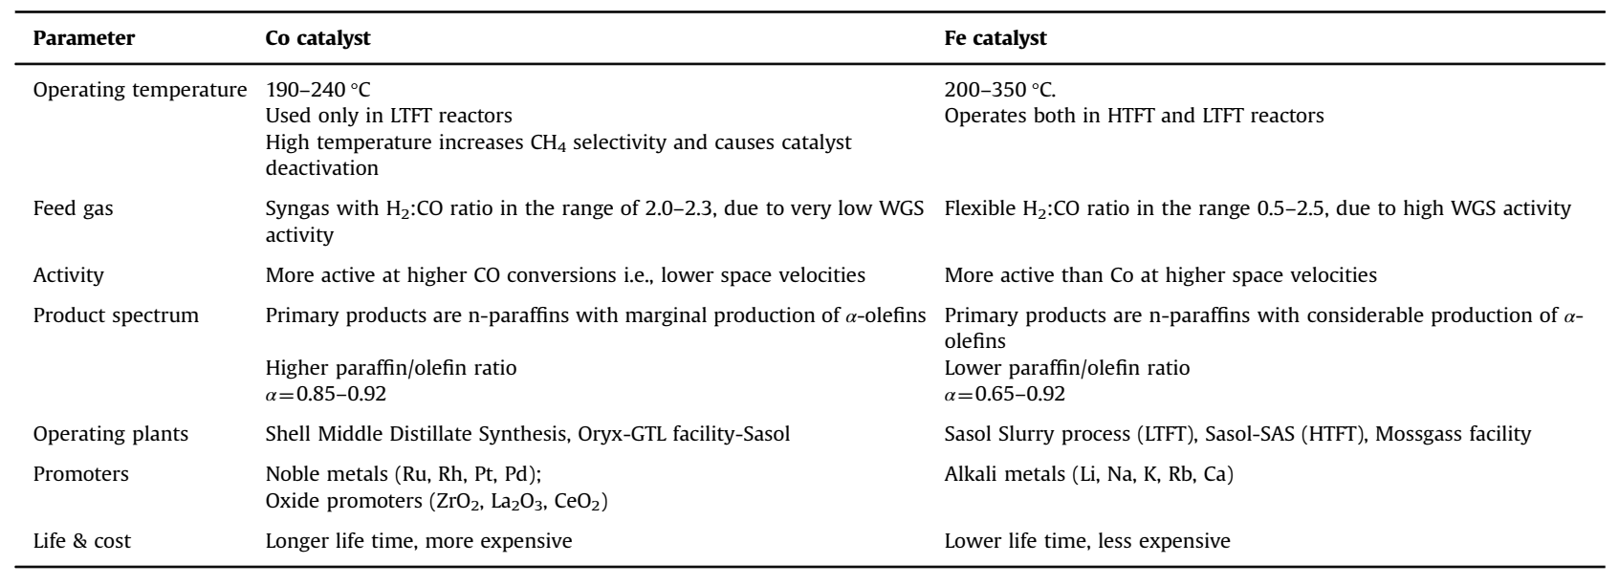
Comparison of some salient features of cobalt and iron FT catalysts

Slide 20
Benefits of FT synthesis from biomass
Generation of biofuels from perennials grown on degraded crop lands and from waste biomass can reduce habitat destruction, competition with food production, and carbon debts
FT-liquids are conceivably well suited for use in fuel cell vehicles
The cost of biomass – could be challenging
Fossil fuel derived gasoline, diesel and natural gas have the energy ratio ranging from 0.83 to 0.95.
Palm oil derived transesterified bio-diesel have energy ratio in the range of 8.5–9.5 and, the liquid fuels derived from bio-syngas, via FT process, yield an energy ratio in the range of 3–6.8.
*Energy ratio: ratio of the energy output of the end product to the fossil energy required for producing the desired fuel

Slide 21
Cont..
Issue with palm oil – challenging plantation (required specific climate)
the liquid fuels obtained from FT process have similar combustion properties as the gasoline and diesel obtained from petroleum sources.
Can replace the fossil derived transportation fuel directly without altering the properties of the combustion devices or its efficiencies.
However – challenging to have sustainable feedstock

Slide 22
Further reads:
Steynberg, A. P., Dry, M. E., Davis, B. H., & Breman, B. B. (2004). Fischer-tropsch reactors. In Studies in Surface Science and Catalysis (Vol. 152, pp. 64-195). Elsevier.
Saeidi, S., Nikoo, M. K., Mirvakili, A., Bahrani, S., Amin, N. A. S., & Rahimpour, M. R. (2015). Recent advances in reactors for low-temperature Fischer-Tropsch synthesis: process intensification perspective. Reviews in Chemical Engineering, 31(3), 209-238.

Slide 23
Algae biorefineries

Slide 24
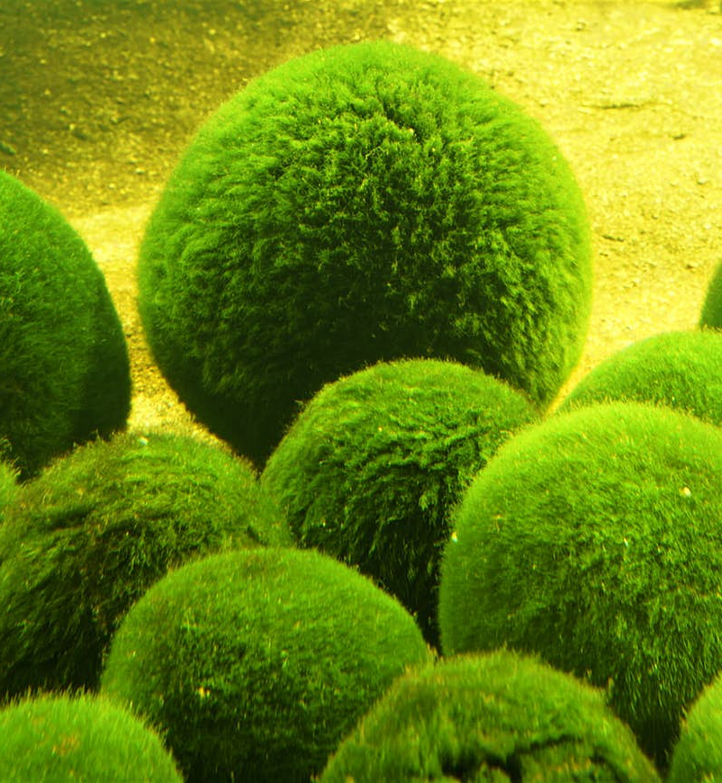
Direct land competition between food and energy crops is one of the main challenges faced by crop-based biofuels.
Algae are especially attractive because of their capacity to produce large amounts of oil per unit of land area compared to other feedstocks.

Slide 26
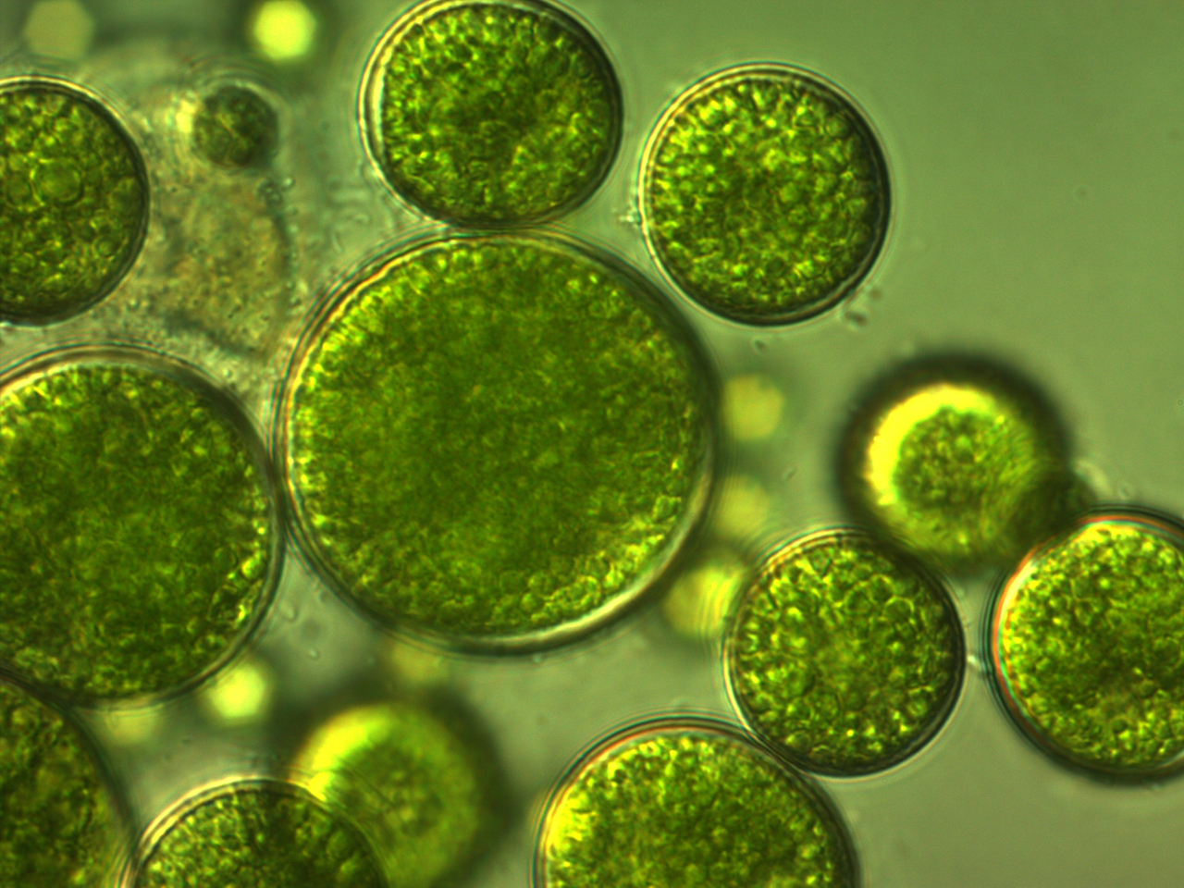
Algae
Photosynthetic organisms that grow in water and in the presence of sunlight and CO₂.
While growing, algae produce and accumulate oil suitable for biodiesel production.

Slide 27
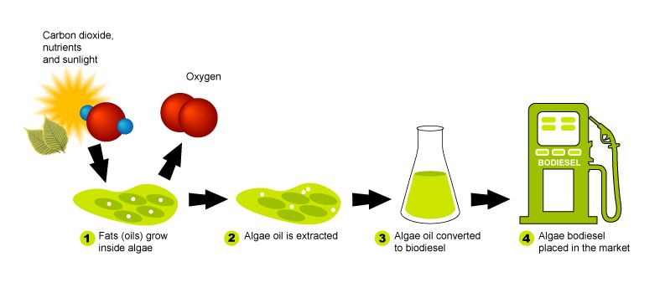

Slide 28
Challenge
High capital cost for algae cultivation and oil extraction as compared to growing oil crops such as palm oil or jatropha.

Slide 29
What to do with the waste?
Proteins and the residual biomass can be recovered from algae.
Proteins can be used for animal feed and the residual biomass can be used as fertilizer.

Slide 30
Algae cultivation
Open ponds
Photobioreactors

Slide 31
Open Ponds
Artificial open ponds using natural sunlight for microalgae photosynthesis and growth.
Type: raceway open ponds
Constant circulation and mixing is required to stabilize algae growth and productivity - performed by a motor-operated paddle wheel
Algae biomass is collected at the harvest point on the other side of the paddle wheel.
Carbon dioxide - surrounding air or by waste streams from other industries (e.g., flue gas).

Slide 32
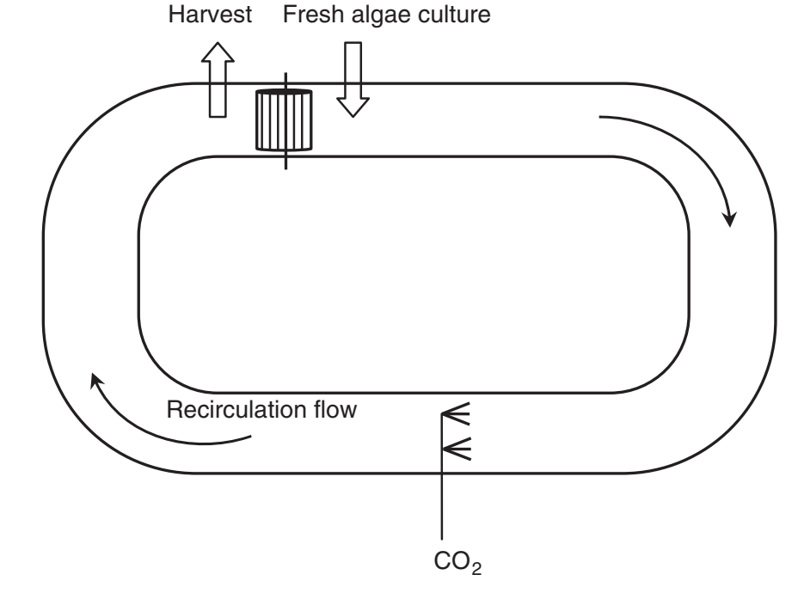
Open Pond

Slide 33
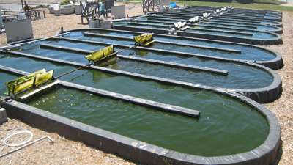

Slide 34
Factor influence algae growth in open pond cultivation
Light - Algae biomass production increases with light intensity until an optimum point is reached
Temperature - The algae growth rate increases with temperature. A maximum rate is achieved at an optimal value of temperature.
Carbon dioxide

Slide 35
Photobioreactors
Closed reactors made of transparent material such as glass or plastic.
Agitation and mixing is performed by recirculating the liquid culture medium using a mechanical pump or by an airlift system.
PBRs can be modified to use a combination of sunlight and artificial lights – halogen lamps.

Slide 36
Type of PBR
Flat PBR
Bubble tube PBR
Tubular PBR

Slide 37
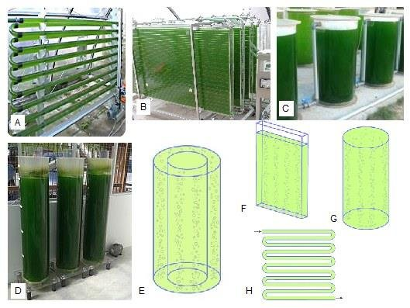

Slide 38
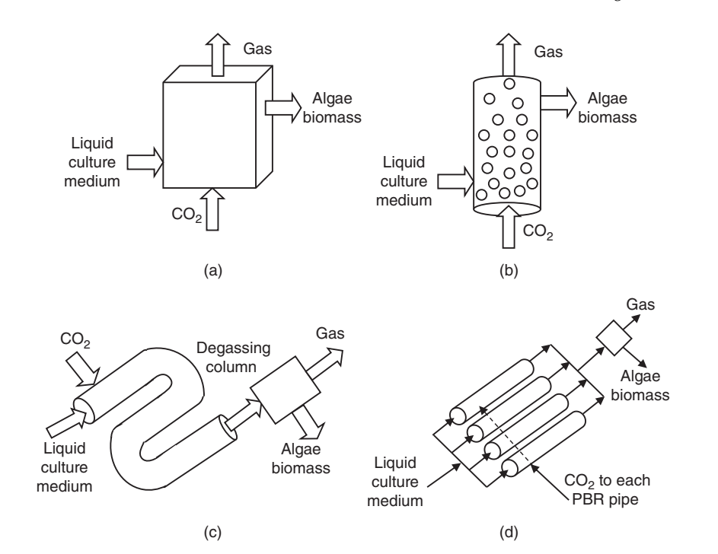
Plate PBR
bubble column PBR
interconnected tubular PBR
parallel tubular PBR

Slide 39
Comparison Open Pond and PBR cultivation
Factor | Open ponds | Photobioreactors
Biomass productivity | Varies productivity | Improved algae and oil yield
Cultivation environment | Low energy input for mixing and agitation | Controlled cultivation Enhanced O₂ and CO₂ transfer rate by agitation and mixing by pump/airlift
Risk of contamination | High risk – contaminated by other microorganism | Lower risk
Operating cost | Low cost | High cost
Space required | High | Moderate
Maintenance | Easy | Difficult

Slide 40
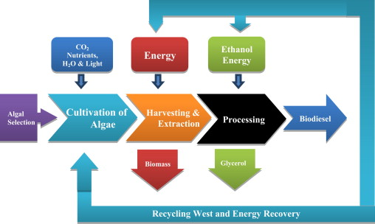

Slide 41
Algae harvesting and oil extraction
Separation of algae cells from the bulk suspension by coagulation–flocculation and flotation or gravity sedimentation - 2–7% by mass
Dewatering of the slurry in order to concentrate the algae biomass using centrifugation, filtration, evaporation - 25% (mass basis)

Slide 42
Purpose flocculation-coagulation
Aggregation of microalgae cells is not spontaneous due to the electrostatic repulsion of the negatively charged cells.
Microalgae suspension is highly stable. Coagulation refers to destabilization of the particle by the coagulant, so particle starts to agglomerate.
Flocculation refers to further agglomeration.
Coagulation involve vigorous mixing to ensure maximum contact with coagulant and the particles.
Flocculation requires slow agitation to avoid breaking down of particles but enough to ensure collision between micro floccules and coagulation and flocculation agents.
A flocculation agent can be added to generate floccules of a proper size with a binding strength enough to prevent them from tearing apart.

Slide 43
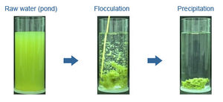
Coagulation refers to the destabilization of the particles by a chemical agent (coagulant) so that the particles can start to agglomerate.
Flocculation refers to further agglomeration of the microfloccules into particles of a bigger size by collisions between them and the coagulation agent.

Slide 44
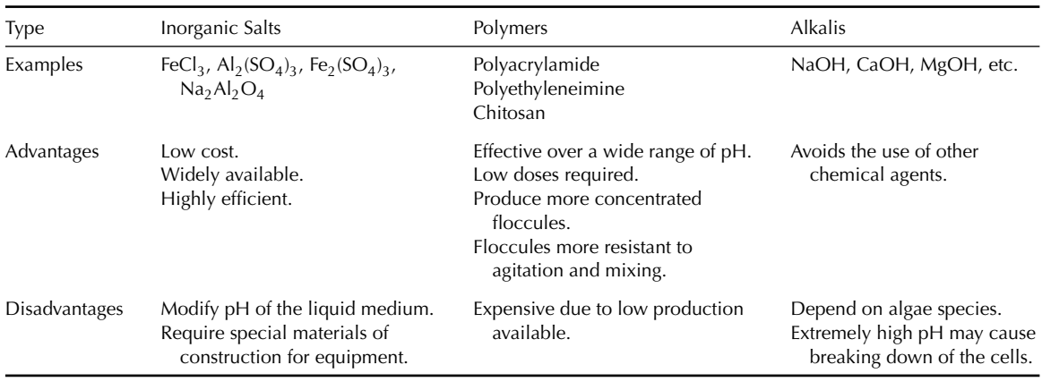
Coagulation-flocculation agents

Slide 45
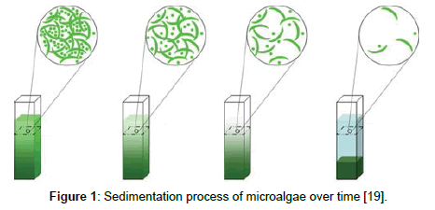
Sedimentation
Separation of destabilized suspended solids by the force of gravity.
The settling characteristics of the suspended solids are determined by the sedimentation velocity and the density and radius of the particles.

Slide 46
Algae oil extraction
Mechanical – expeller press, ultrasonication, magnetic fields
Chemical – Soxhlet extraction, supercritical fluid extraction

Slide 47
Algae biodiesel production
The main components of algal oil are triglycerides.

Slide 48
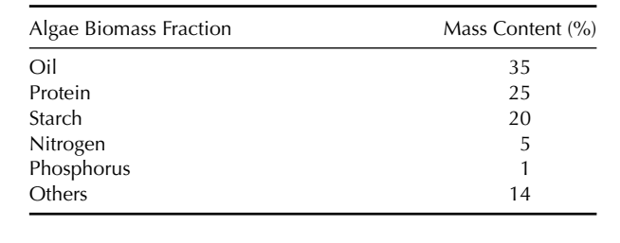
Mass content of the various algae biomass fractions

Slide 49
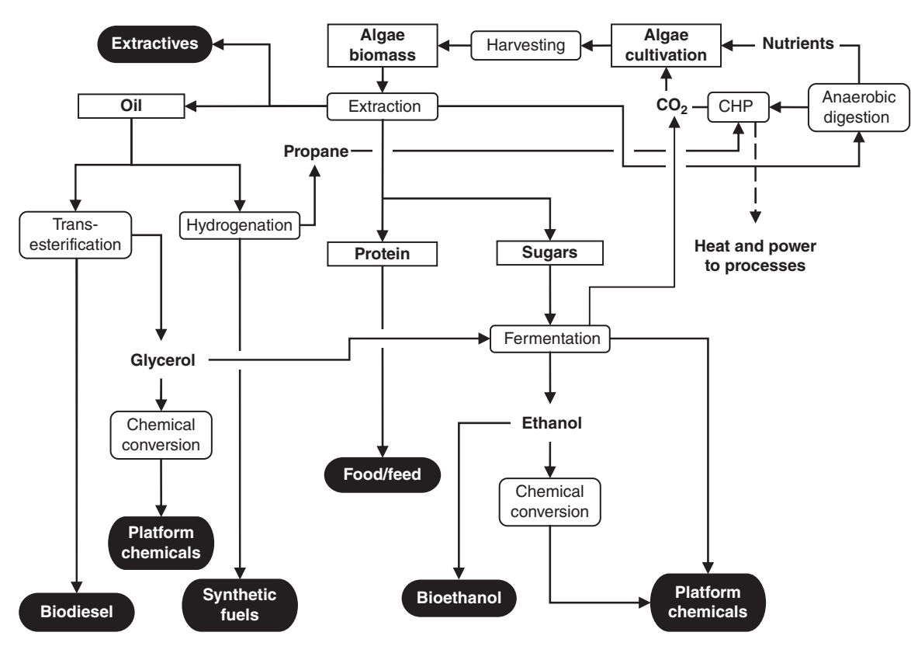

Slide 50
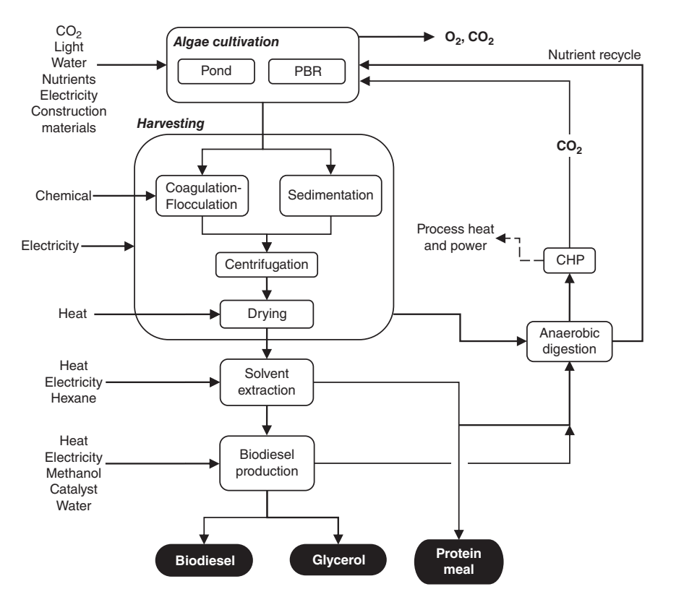
Biorefinery system flowchart producing biodiesel, glycerol and protein meal from algae oil.

Slide 51
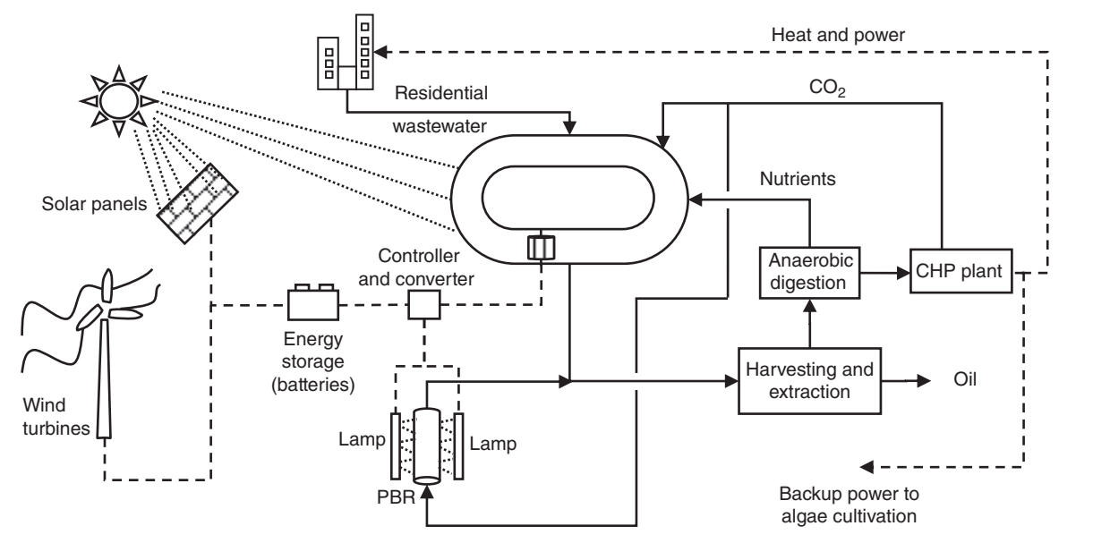
Integration of algae cultivation with other natural, industrial and residential elements of the ecosystem
*combined heat and power (CHP)

Slide 52
Although microalgae is expensive to be scaled-up, these are few key reason to look towards production of bio-diesel from microalgae:
Rapid growth rate
High energy content
Ability to feed on high levels of CO₂ from fossil fuel combustion
Capability of growing algae in low quality water

