Slide 1
EKC 464 BIOREFINERY ENGINEERING
Nur Ayshah Rosli, PhD
Room No: 2.22
Ext: 6487

Slide 2
Fundamental of Design Calculation

Slide 3
Introduction
Designing the thermochemical conversion processes of biomass involves the assessment of process performance with respect to material utilization and energy efficiency.
Modeling of these processes requires the application of fundamental concepts of reaction thermodynamics, and thereby identification of key operating parameters and performance indicators depending upon feed definition and process yields.
Various fundamental design calculations for combustion, gasification and pyrolysis, providing important tools to assess the process performance.

Slide 4
Fundamentals of Design Calculation
Heat of Combustion
Heating values (HHV & LHV)
Adiabatic flame temperatures
Air-to-fuel ratio
Cold and Hot gas efficiencies
Equivalence ratio
Carbon conversion
Heat of reaction
Combustion
Gasification

Slide 5
COMBUSTION

Slide 6
Heat of combustion
Determined experimentally using bomb calorimeter – at standard pressure and temperature.
Limited data available at various operating condition.
Need straightforward approach to estimate heat of combustion at different temperatures.

Slide 7
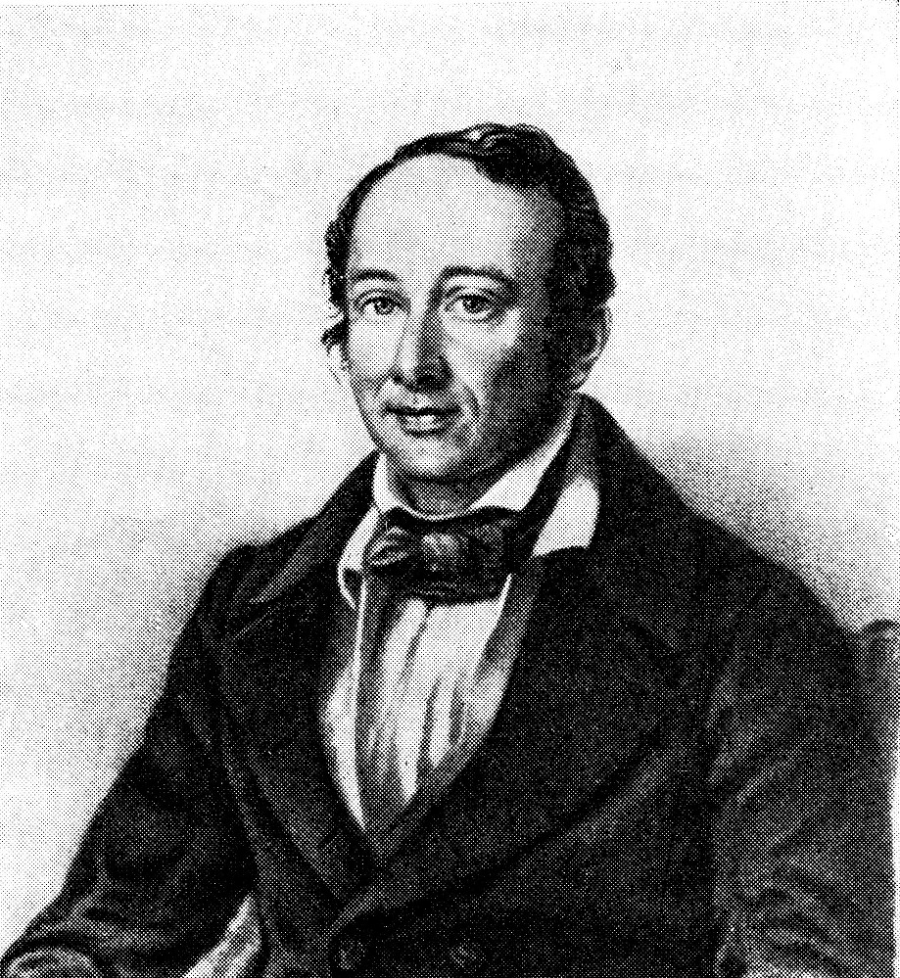
Hess’s Law
Hess’s law states that the enthalpy change of a reaction is independent of the path between the initial stage and final stage, by which the reactant(s) is/are converted into the product(s)

Slide 8
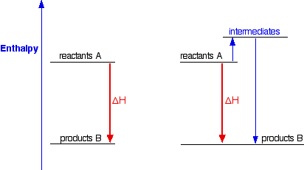
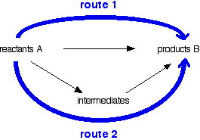
Explaining Hess’s Law
The enthalpy change accompanying a chemical change is independent of the route by which the chemical change occurs.

Slide 9
To determine the heat of combustion of a compound at a desired temperature using Hess’s law, the minimum data requirements are:
Initial temperature and final temperature of the reaction
Standard heat of formation of reactant(s) and product(s)
Heat capacities of reactant(s) and product(s)

Slide 10
Step 1: Determine the Standard Heat of Combustion
The information required is:
Standard heat of formation of the reactant(s) to form the intermediate product(s)
Standard heat of formation of the intermediate product(s) to form the product(s)

Slide 11
$${∆H°}_{c} ={∆H°}_{f,1}+{∆H°}_{f,2}$$
$${∆H°}_{c} =\sum{\left(n{∆H°}_{f,product}\right)}−\sum{\left(n{∆H°}_{f,reactant}\right)}$$
Where;
${∆H°}_{c}$ is the standard heat of combustion.
n is the stoichiometric number of moles
${∆H°}_{f,product}$and ${∆H°}_{f,reactant}$are the standard heats of formation of the product and reactant

Slide 12
Step 2: Determine the Heat of Combustion at the Desired Initial and Final Temperatures
In accordance with Hess’s law, for calculating the heat of combustion of a reaction, the following information is required:
Initial temperature and final temperature of the combustion reaction.
Standard heat of combustion, obtained in Step 1
Heat capacities of reactant(s) and product(s)
The heat of combustion of a reaction, ${∆H}_{c}$,
${∆H}_{c} ={∆H}_{R}+{∆H°}_{C}+$ ${∆H}_{P}$

Slide 13
Calculation of heat of combustion of a reaction using an alternative pathway

Slide 14
${∆H}_{c} ={∆H}_{R}+{∆H°}_{C}+$ ${∆H}_{P}$
Where,
$${∆H}_{R }=\int_{T_{1}}^{298}{C_{p,reactant} dT}$$
$C_{p,reactant}$ is the specific heat capacity of reactant(s).
Also,
$${∆H}_{P }=\int_{298}^{T_{2}}{C_{p,product} dT}$$
$C_{p,product}$ is the specific heat capacity of product(s)

Slide 15
Examples of the standard heat of combustion at 298 K.

Slide 16
In-class Exercise
Calculate the standard heat of combustion of methane using Hess’s Law.
Table A: Standard heat of formation of components involved in methane combustion3.
$${∆H°}_{c} =\sum{\left(n{∆H°}_{f,product}\right)}−\sum{\left(n{∆H°}_{f,reactant}\right)}$$

Slide 17
Step 1:
Write the combustion reaction of methane
CH₄ + 2O₂ → CO₂ + 2H₂O
$${∆H°}_{f,1}$$
$${∆H°}_{f,2}$$
$${∆H°}_{f,3}$$
$${∆H°}_{f,4}$$
Step 2:
From Hess’s Law,
$${∆H°}_{c} ={∆H°}_{f,1}+{∆H°}_{f,2}$$
$${∆H°}_{c} =\sum{\left(n{∆H°}_{f,product}\right)}−\sum{\left(n{∆H°}_{f,reactant}\right)}$$

Slide 18
So,
${∆H°}_{f,1}+{∆H°}_{f,2}{ + ∆H°}_{c} =$ ${∆H°}_{f,3}+{∆H°}_{f,4}$
$${{ ∆H°}_{c} =\left({∆H°}_{f,3}+{∆H°}_{f,4}\right)−\left({∆H°}_{f,1}+{∆H°}_{f,2}\right)}_{}$$
$${∆H°}_{c} =\sum{\left(n{∆H°}_{f,product}\right)}−\sum{\left(n{∆H°}_{f,reactant}\right)}$$
$${∆H°}_{c}=−802.6 kJ/mol$$

Slide 19
Higher and lower heating Values
Heating values are used to compare the quality among different fuels and also to deduce the thermodynamic efficiency of the process, in which the fuel is used as the feedstock.
In general, the heating value is the quantity of heat produced from complete combustion of a unit quantity of fuel.
There are two types of heating values commonly reported: the higher heating value (gross calorific value) and the lower heating value (net calorific value). The distinction between these two values is the state of water.
The higher heating value considers water to be in the liquid phase and thus the heat of vaporization of water is included. The lower heating value refers to water in vapor form.

Slide 20
HHV = LHV + m_{COND}h_{vap}
Where,
HHV is the higher heating value of fuel.
LHV is the lower heating value of fuel.
m_{COND} is the mass of water formed.
h_{vap} is the latent heat of vaporization of water at the standard condition, that is, 25 ◦C.

Slide 21
In the case of biomass, LHV can be related to HLV using:
LHV_{dry} = HHV_{dry} - $\frac{21.822 H}{100}$
where,:
LHV_{dry} and HHV_{dry} are the lower and higher heating values on dry basis,
MJ kg⁻¹.
H is the weight percent of hydrogen, determined in the ultimate analysis.

Slide 22
Estimation of HHV based on proximate analysis
HHV = −3.0368 + 0.2218 VM + 0.2601 FC
HHV = 19.914 – 0.2324 Ash
Estimation of HHV based on ultimate analysis
HHV = -1.3675 + 0.3137 C + 0.7009 H + 0.0318 O
where HHV is measured in MJ kg⁻¹ and VM, FC, C, H and O represent volatile matters, fixed carbon, carbon, hydrogen and oxygen, respectively. These are in weight percent based on dry biomass. The O element embraces all other elements such as S, N, Cl, etc., that is, O = 100 – C – H – Ash.

Slide 23
Example of proximate and ultimate analyses of biomass.
In analytical chemistry the practice of lumping together a variety of components and reporting them as a single entity is called proximate analysis. The proximate analysis of coal is therefore the determination of moisture of volatile matter, fixed carbon, and ash.
Ultimate analysis is basically a breakdown of the fuel into its elemental components through an analysis of the products that remain after the complete combustion of a small fuel sample.

Slide 24
In-class Exercise
Estimate the HHV values of redwood based on proximate and ultimate analyses shown in Table A and compare them against the measured HHV.

Slide 25
Solution
Estimation of HHV based on proximate analysis
HHV = −3.0368 + 0.2218 VM + 0.2601 FC
HHV = 19.914 – 0.2324 Ash
Estimation of HHV based on ultimate analysis
HHV = -1.3675 + 0.3137 C + 0.7009 H + 0.0318 O
19.83 MJ/kg⁻¹
19.83 MJ/kg⁻¹
20.07 MJ/kg⁻¹

Slide 26
Adiabatic Flame Temperature
Adiabatic flame temperature is the maximum temperature that can be achieved in a combustion process, when there is no heat and work transferred to or from the system.
This is a crucial condition because combustion is a fast reaction and the safety precaution needs to be considered.
The reactor temperature must be prevented from rising too fast.
For adiabatic combustion reaction, ∆Hc = 0.
So, $0={∆H}_{R}+{∆H°}_{C}+$ ${∆H}_{P}$

Slide 27
Theoretical Air-to-Fuel Ratio
The air-to-fuel ratio (R_{AF}) is the ratio of mass of air (m_{air}) to the mass of fuel (m_{fuel}) in a mixture, in the context of a combustion process, defined as:
$$R_{AF}=\frac{m_{air}}{m_{fuel}}$$
If a fuel is completely combusted in an environment with a strictly sufficient amount of air, that is, without the presence of any excess of air, this is known as stoichiometric or theoretical combustion.
The minimum amount of air required for a complete combustion is known as stoichiometric or theoretical air.

Slide 28
Another common parameter used as the indicator for the combustion process – the stoichiometric ratio, 𝜆 – is the actual air-to-fuel ratio to the stoichiometric air-to-fuel ratio, defined as
$$λ=\frac{{\left(R_{AF}\right)}_{actual}}{{\left(R_{AF}\right)}_{stoic}}=\frac{{\left(m_{air}/m_{fuel}\right)}_{actual}}{{\left(m_{air}/m_{fuel}\right)}_{stoic}}$$
Therefore,
𝜆 = 1.0 → stoichiometric condition 𝜆 > 1.0 → fuel-lean condition 𝜆 < 1.0 → fuel-rich condition

Slide 29
Excess air is often needed for complete combustion.
Typically, biomass with a high moisture content requires approximately 70% excess air, equivalent to 10 tonne of air for 1 tonne of biomass.
The excess air requirement is in the order of solid fuel > liquid fuel > gaseous fuel.

Slide 30
GASIFICATION

Slide 31
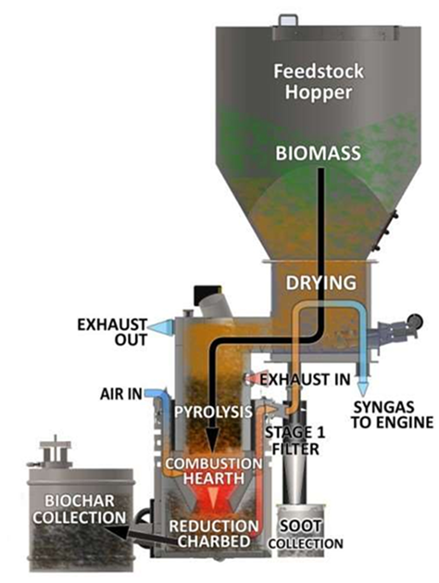
Cold Gas Efficiency
The product gas of gasification at high temperature is cooled down to a lower temperature in order to recover heat for satisfying the demand by the downstream processes.
The cold gas efficiency is calculated based on the products after being cooled; in other words, the sensible heat is assumed not to be recoverable.
The cold gas efficiency often falls within the range of 60–80% in the modern commercial gasification unit.

Slide 32
Cold gas efficiency, $η_{CG}$,
$$η_{CG}\left(\%\right)=\frac{Heating value in cooled product gas}{Heating value in fuel}×100$$

Slide 33
Hot Gas Efficiency
Sometimes, the high temperature product gas from gasification is utilized directly in other equipment such as a boiler and thus cooling of the gas may not be needed.
The calculation of the hot gas efficiency assumes that the product gas remains at a high temperature so that the sensible heat of the hot gas is also utilized.
The hot gas efficiency is greater than the cold gas efficiency
Hot gas efficiency, $η_{HG}$,
$$η_{CG}\left(\%\right)=\frac{Heating value in hot product gas+Sensible heat of the hot gas}{Heating value in fuel}×100$$

Slide 34
Equivalance Ratio
The equivalence ratio, 𝜙, defined below is a strong parameter that determines the performance of the gasifier as well as the quality of the product gas.
Where:
m_{fuel} is the mass flow rate of fuel and m_{air} is the mass flow rate of air.
$$φ=\frac{{\left(m_{air}/m_{fuel}\right)}_{actual}}{{\left(m_{air}/m_{fuel}\right)}_{stoic}}$$

Slide 35
For gasification, 𝜙 > 1 since the reaction is carried out in an air-deficient environment, in contrast to the combustion reaction, where excess air is used (𝜙 < 1).
𝜙 = 1 is when stoichiometric air is used with respect to the fuel.
For gasification of biomass, 3 < 𝜙 < 5. 𝜙 = 4 is normally a good initial guess for modeling gasification of biomass.
Adjustment of 𝜙 is needed, because it dictates the quality of the products formed.
High 𝜙 results in a low gas yield while producing a high proportion of char and tar, that is, the pyrolysis reaction dominates the gasification reaction.
Low 𝜙 results in more combustion products formation, that is, the combustion reaction dominates the gasification reaction.
Both scenarios (low and high 𝜙) would lead to a low heating value of the product gas. This is because at high 𝜙, char and tar are produced rather than the product gas; at low 𝜙, more CO₂ and H₂O are generated instead of CO and H₂.

Slide 36
Carbon Conversion
Carbon conversion, X_{C}, defined below shows the efficiency of utilization of the carbon element in the fuel:
$$X_{c}\left(\%\right)=\frac{Carbon converted in gasification}{Carbon in the feed}×100$$

Slide 37
Heat of Reaction
The heat of reaction for gasification can be determined in the same way as for the combustion reaction, using Hess’s law concept.
However, there are numerous reactions involved in a gasification process, and thus it is not straightforward to determine the heat of reaction by specifying all the reactions.
May include partial oxidation and steam reforming reactions in the calculation.

Slide 38
Thermochemical Processing of Biomass
General features, fundamental of design calculation & process design

Slide 39
Process Design Synthesis and Modelling

Slide 40
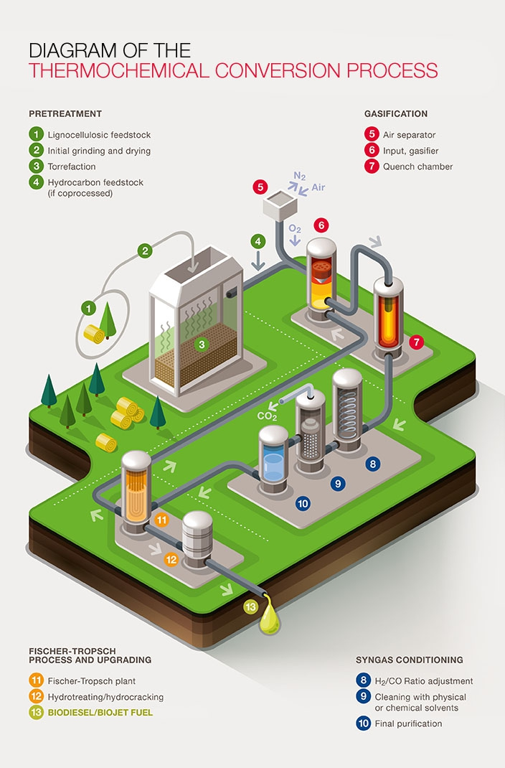

Slide 41
Combustion model
The combustion reaction – reaction of fuel with excess oxygen, either pure oxygen or air, resulting in a mixture of gas containing mainly CO₂ and H₂0.
Combustion reaction can be modeled as:
$$C_{m}H_{n}+\left(m+\frac{n}{4}\right)O_{2}→m{CO}_{2}+\left(\frac{n}{2}\right)H_{2}O$$
If the reaction of other impurities with oxygen are taken into account:
$$CH_{a}O_{b}N_{c}S_{d}+y\left(O_{2}+{3.76N}_{2}\right)→{CO}_{2}+\left(\frac{a}{2}\right)H_{2}O+\left(\frac{c}{2}+3.76y\right)N_{2}+d{SO}_{2}$$

Slide 42
$$CH_{a}O_{b}N_{c}S_{d}+y\left(O_{2}+{3.76N}_{2}\right)→{CO}_{2}+\left(\frac{a}{2}\right)H_{2}O+\left(\frac{c}{2}+3.76y\right)N_{2}+d{SO}_{2}$$
where the number of moles of air, y can be defined as
$$y=1+\frac{a}{4}+d−\frac{b}{2}$$
Figure Deducing molar composition of an element in the fuel based on ultimate analysis.

Slide 43
Table Calculation of number of moles and mole fraction of products from combustion.
The coefficient a, b, c, d, in the $CH_{a}O_{b}N_{c}S_{d}$ can be represented by;
$$a=\frac{12q}{p};b=\frac{3r}{4p};c=\frac{6s}{7p};d=\frac{3r}{8p}$$

Slide 44
Further reading at:
Ranzi, E., Corbetta, M., Manenti, F., & Pierucci, S. (2014). Kinetic modeling of the thermal degradation and combustion of biomass. Chemical Engineering Science, 110, 2-12.
Sousa, N., & Azevedo, J. L. (2016). Model simplifications on biomass particle combustion. Fuel, 184, 948-956.
Dernbecher, A., Dieguez-Alonso, A., Ortwein, A., & Tabet, F. (2019). Review on modelling approaches based on computational fluid dynamics for biomass combustion systems. Biomass Conversion and Biorefinery, 9(1), 129-182.

Slide 45
Gasification Model Computational methods
The development of mathematical models and codes that aid in predicting and refining syngas quality is a valuable tool that enables the optimization of operational variables, resuming the experimental work and ensuring greater efficiency for the process.
Modeling may also draw attention to system limitations and undesired operation zones, saving the equipment itself from being exposed to hazardous conditions

Slide 46
A reliable mathematical model should:
Provide a set of optimum operating conditions
Designate the system hazards and limitations
Predict gasification experiments and outputs for a set of variable operational conditions, including different feedstocks
Help to understand and explain experimental results
Be suitable for scale-up experiments

Slide 47
Solving the modeling equation
Numerical method - Matlab
Simulation method – Aspen Plus, Aspen HYSYS, PRO//II

Slide 48
Gasification modeling
kinetic models
thermodynamic equilibrium models – Gibbs Free Energy Minimization method
computational fluid dynamics (CFD)
artificial neural networks (ANN)
For more reading - Ramos, A., Monteiro, E., & Rouboa, A. (2019). Numerical approaches and comprehensive models for gasification process: A review. Renewable and Sustainable Energy Reviews, 110, 188-206.

Slide 49
Summary of gasification models based on the output of each and the variables used

Slide 50
Pyrolysis model
The thermal decomposition of biomass via pyrolysis reaction is widely modeled using the Waterloo concept.
The model assumes that the pyrolysis reaction proceed in a two-stage mechanism.
Waterloo concept for modeling the biomass pyrolysis reactions

Slide 51
The rate equation of biomass pyrolysis as proposed in the Waterloo concept;
where m_{B}, m_{G}, m_{O} and m_{C} denote the mass fraction of biomass, gas, oil and char, respectively, and k₁, k₂, k₃ and k₄ are the rate constants. For first-order reaction rate constants, the unit is s^{−1;}
and t is any time during the reaction duration.

Slide 52
At t = 0, m_{B} = 1, m_{G} = 0, m_{O} = 0 and m_{C} = 0. These boundary conditions are applied during the integration of the set of first-order differential equations, of which the results after integration are shown below;

Slide 53
In order to solve these equations, the rate constants (k, k₁, k₂, k₃ and k₄) and the residence time are needed.
global rate constant k – thermogravimetric (TGA) analysis
Simultaneous calculation from previous equation, to get values of k₁, k₂, k₃ and k₄
where R is the universal gas constant, 8.314 kJ kmol⁻¹ K⁻¹, and T is the pyrolysis reaction temperature, K.

Slide 54
Further reading at:
Maziarka, P., Anca-Couce, A., & Ronsse, F. (2020). Review on modelling approaches based on computational fluid dynamics for biomass pyrolysis systems. In Z. Fang, R. L. Smith, Jr, & L. Xu (Eds.), Production of biofuels and chemicals with pyrolysis. Springer.

