Slide 1
IBK412: Environmental Bioprocess Technology
By
Muaz bin Mohd Zaini Makhtar
Email: muazzaini@usm.my ANNEX Building, Room A401
1

Slide 2
What moment you have the smile in your face, but honestly you don’t
like that photo at all? Mind to share what was the situation and why it
happened?
Go to www.menti.com and use the code 65 75 593

Slide 3
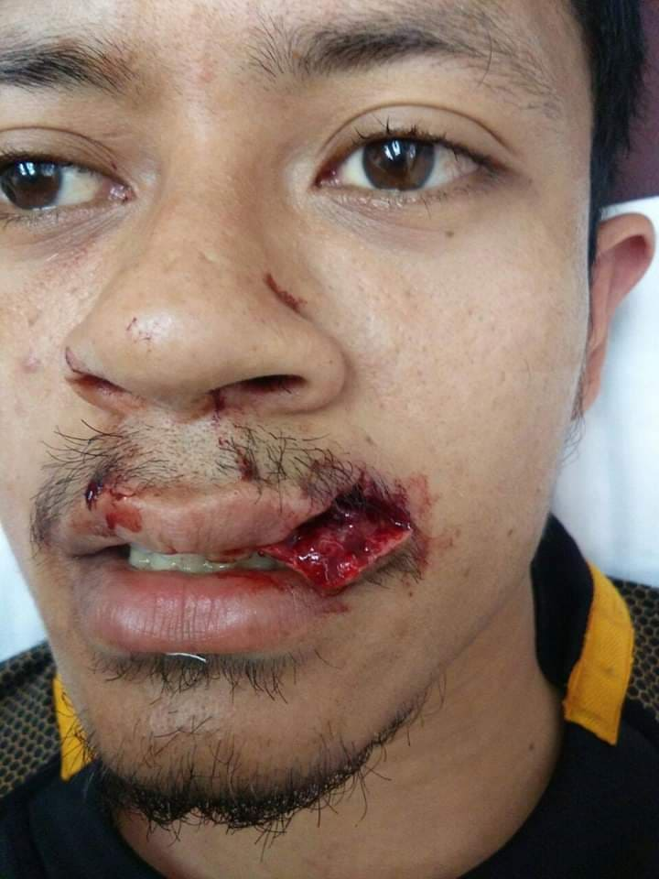
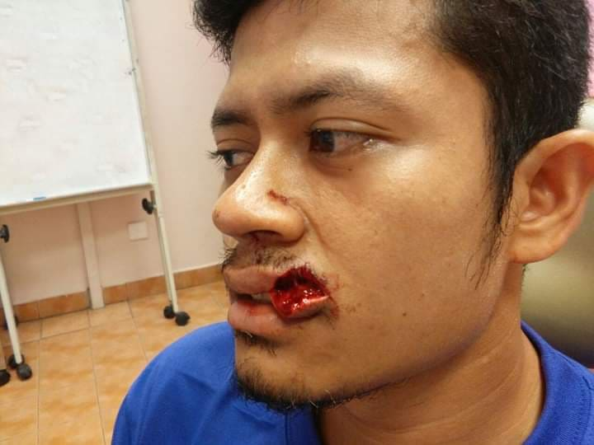
Moment where I missed my smile.. huhu

Slide 4
Moment where I missed my smile.. huhu

Slide 5
Section Break

Slide 6
WASTEWATER
DOMESTIC WASTE
INDUSTRIAL WASTE
Wastewater

Slide 8
ASSIGNMENT (Due Date 5 NOv 5am)
Part A
State the percentage (%) composition inside the sludge for these following elements: - Macronutrient
- Micronutrient
- Trace element *Need to mention your type of wastewater and cite the source of your finding (Endnote/Mendelley).
Part B
State the recent function of sludge from WWTP: - Brick
- soil conditioner / fertilizer
Soil reclamation
Part C
Two other relevant application
*cite the source of your finding (Endnote/Mendelley)

Slide 9
Allocation Marks (52/52 marks ~ 100 %)
Part A
Table for different type of wastewater (state the source of the sludge):
macro (4 marks) , micronutrient (4 marks) and trace element(4 marks)
Part B ( 12 marks x 3 application = 36 marks)
Well elaborate the application in each sludge application(2)
the techniques used ; mechanism (6 marks)
the impacts toward yield/aims/ the efficiency (4 marks).
Part C
The ‘others’ application (2 marks)
**Usage of endnote/ mendelley (2 marks)

Slide 10
REFRESH OF WASTEWATER TREATMENT

Slide 15
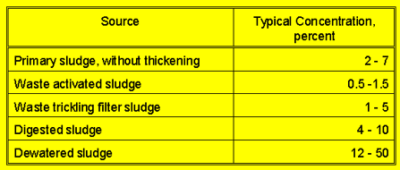
Sludge Characteristic

Slide 16
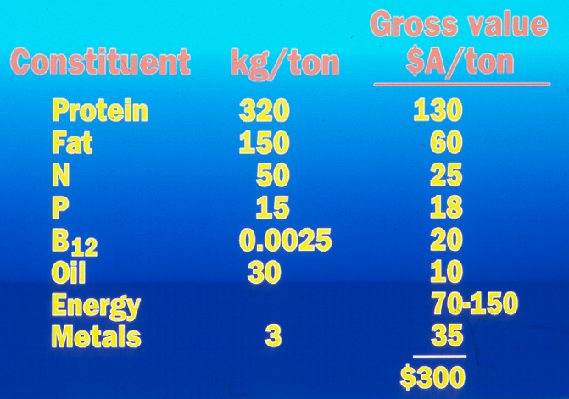
Value of Sludge Composition

Slide 17
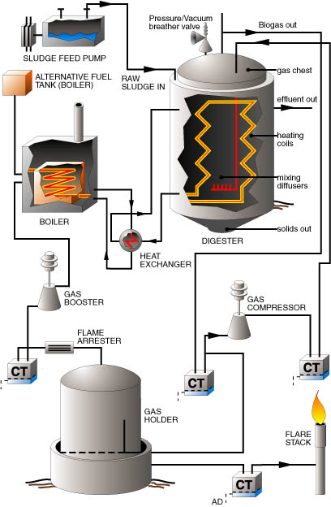
Sludge Digestion: Anaerobic

Slide 18
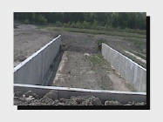
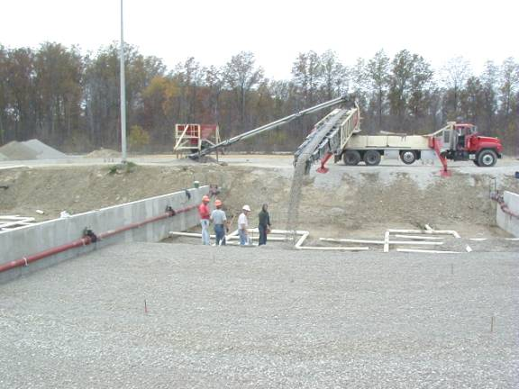
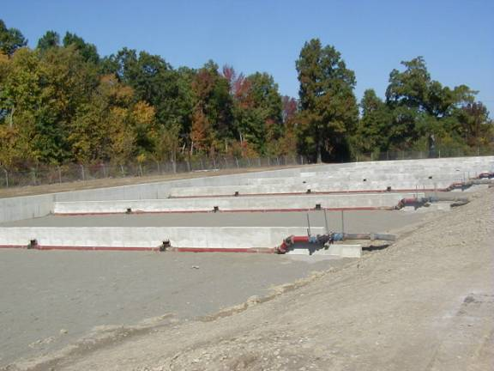
Sludge drying bed: preparation
Filling the drying bed with sludge
Starting the
drying process

Slide 19
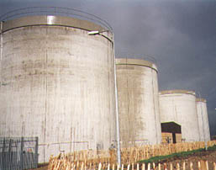
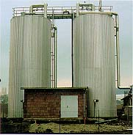

Slide 20
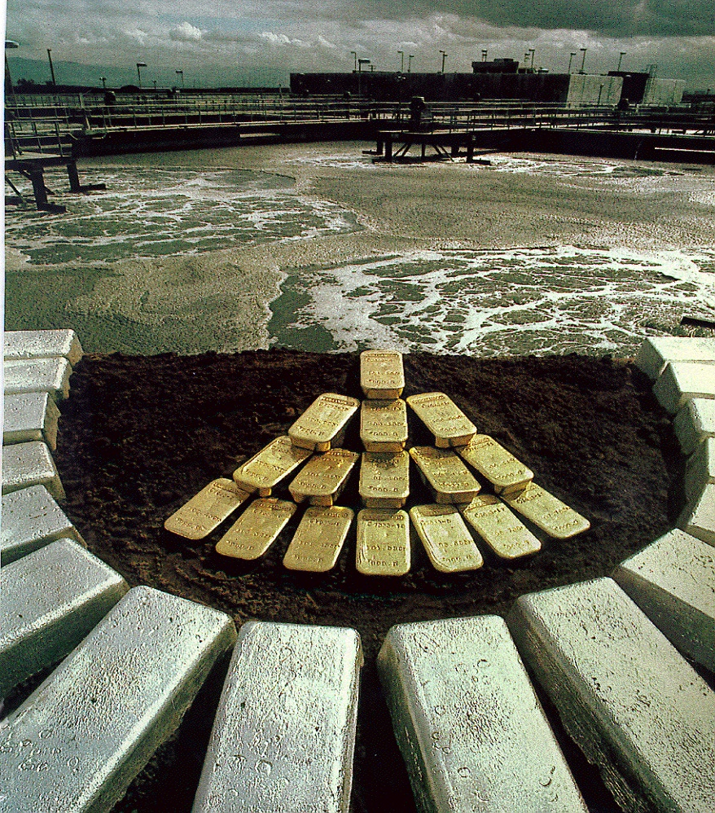
Waste is Wealth

Slide 21
Advance Method in wastewater Treatment
In 1910, a botany professor from University of Durham, UK, had proposed the idea of catalytic activity and conversion of microbes can generate electricity .
Then early in 1990s Allen and Bennetto reported that fuel cell became more attractive and the investigation on MFCs began to start

Slide 22
Microbes Story

Slide 37
Theoretical calculation
Let say IWK Sdn Bhd produces 500 L/d AD, 600 mg/L of COD, 14.7 kJ/g –COD (basis wastewater) The power would be:
$P= \left(600 \frac{mg COD}{L}\right)\left(\frac{500 L}{d}\right)\left( \frac{g}{{10}^{3}mg}\right)\left( \frac{14.7}{g−COD}\right)\left( \frac{1kWh}{3600kJ}\right)\left( \frac{1d}{24h}\right)$ $=0.051 kW$
Let say tariff Tenaga Nasional Berhad RM0.44/kW-h, how much IWK Sdn Bhd save the cost a year by having power at 0.51 kW/day?
$$Value=0.051 kW \left( \frac{RM0.44 }{kWh}\right)\left(\frac{24 ×365 h}{yr}\right) \\ =RM196.57$$
**these calculation all assume 100 % energy recovery, not reasonable. As a goal, it is hope to recover 20 – 30 % of the energy.

Slide 38
How to visualize the power we have instead you see the small amount of RM we managed to save?
We try to show in term of the application.
A wastewater company light their waste pond during night 7 pm to 7 am (12 h) using 3 W LED lamp. So how many LED lamp can be lighted?
$$0.051 kW =51 Watt$$
1 LED lamp = 3 Watt
LED can be lighted up= $\left( \frac{51Watt}{3 Watt}\right)$
= 17 LED throughout a year!

Slide 39
Lagoons

Slide 40
Waste Stabilization Lagoons
A carefully designed structure
constructed to contain and to
facilitate the operation and
control of a complex process
of treating or stabilizing wastewater.

Slide 41
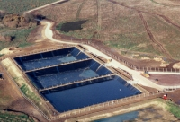
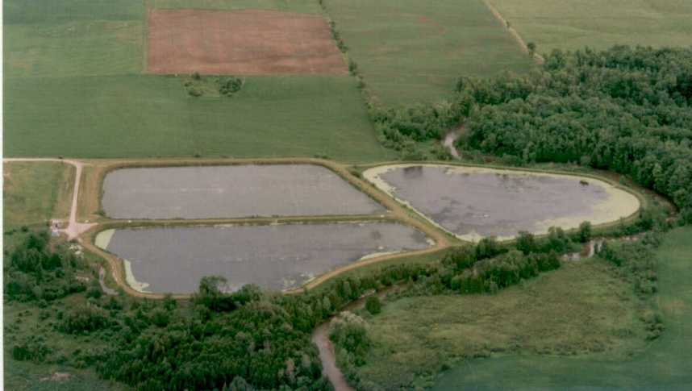
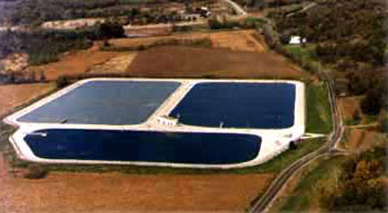
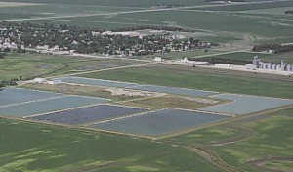

Slide 42
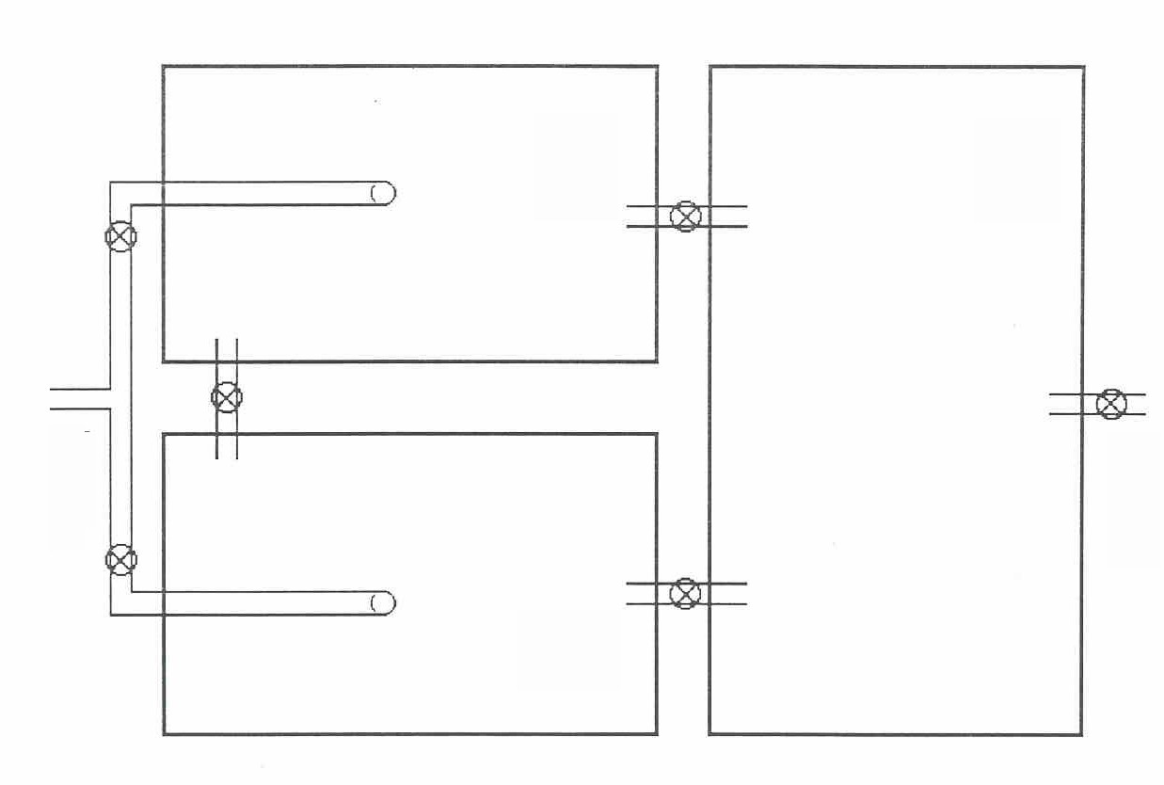
Typical Lagoon System
#1
Influent
Effluent
#3
#2

Slide 43
WASTEWATER
Water used to carry waste products away from homes, schools, commercial establishments, and industrial enterprises.

Slide 44
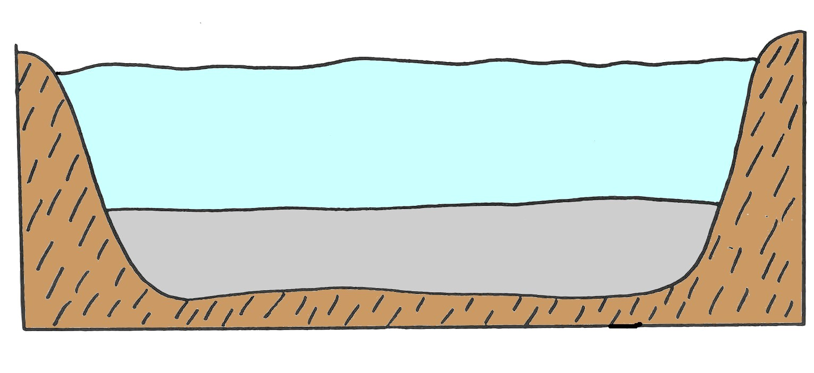
TREATMENT PROCESS

Slide 45
Waste Stabilization Lagoons “Treatment” Process
Natural Process
Same Process Which Occurs in a Natural Pond or Lake
Under Controlled Conditions

Slide 46
Waste Stabilization Lagoons
Natural Process
Same as Mechanical Plants
Carefully Designed and Constructed
Must Be Operated Properly
Must Be Understood

Slide 47
Waste Stabilization Lagoons
“The Process” Involves:
Physical Processes
Chemical Processes
and
Biological Processes

Slide 48
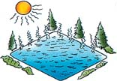
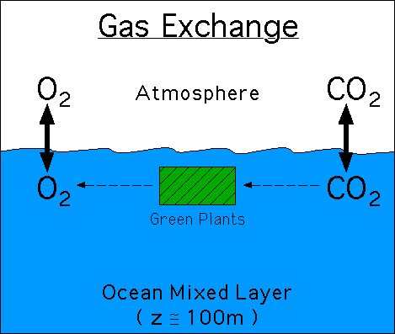
Physical Processes
Evaporation
Seepage
Gas Exchange
Sedimentation
SOLIDS
U.V. Radiation

Slide 49
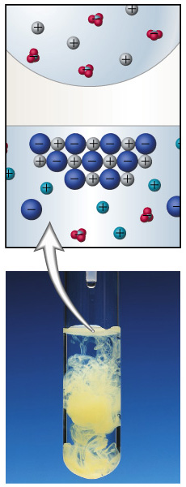
Chemical Processes
Inorganic Activity
Precipitation Formation

Slide 50
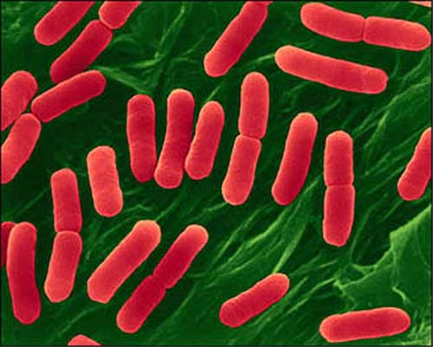
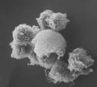
Wastewater “Treatment” Process
Mostly
BIOLOGICAL
*BACTERIA*

Slide 51
BACTERIA Types
Aerobic
Bacteria that can use only oxygen that is “free” or not chemically combined.
Anaerobic
Bacteria that can live in the absence of “free” oxygen.
Facultative
Bacteria that use either “free” or combined oxygen.

Slide 52
Zones in a Lagoon
AEROBIC
FACULTATIVE
ANAEROBIC

Slide 53
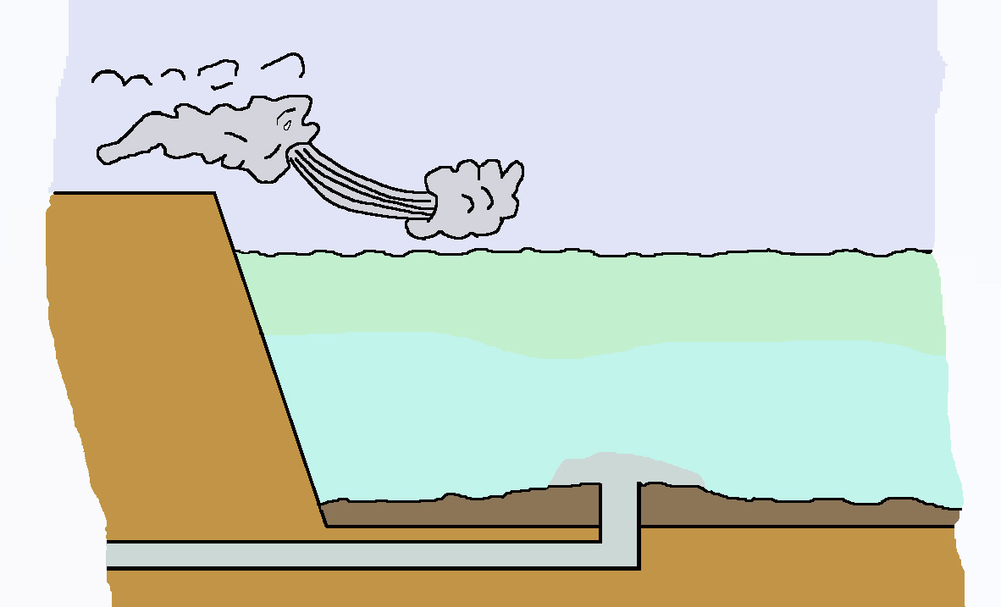
Zonal Relationships in a Lagoon
SUN
O₂
Aerobic Zone
(Dissolved Oxygen Present)
O₂
Dike
Facultative Zone
Anaerobic Zone (No Dissolved Oxygen Present)
Sludge
Sludge
Influent

Slide 54
Zonal Differences
Environments
Bacteria
Activities

Slide 55
ANAEROBIC ZONE
SOLIDS
Sedimentation
Stabilization
Organics
Bacteria
Organic Acids
Carbon Dioxide (CO₂)
Ammonia (NH₃)
Hydrogen Sulfide (H₂S)
Methane (CH₄)
Organic Acids
Bacteria

Slide 56
ANAEROBIC ZONE
SOLIDS
Sedimentation
Stabilization
Not All Of the Settled Solids Will Be Broken Down.
The Sludge Layer Will Increase Slowly Over the Life of the Lagoon

Slide 57
AEROBIC ZONE
Bacteria Use Soluble Organics
Influent
Anaerobic Zone
Respiration

Slide 58
RESIPRATION
Organic
Compounds
+
Carbon
Dioxide
+
Oxygen
Water
CH₂O + O₂
CO₂ + H₂O

Slide 59
Wastewater
New Cells
NH₃
CO₂
H₂O
Slime Layer
Cell
Membrane
Oxygen
Food
Storage
Enzymes
(Absorption)
Soluble Organics
Adsorbed
Particle

Slide 61
FACULTATIVE ZONE
Organisms Utilize Dissolved Oxygen
or Combined Oxygen
Adapt to Changing Conditions
Continue Decomposition
During
Changing Conditions

Slide 62
Zonal Relationships in a Lagoon
SUN
O₂
Aerobic Zone
(Dissolved Oxygen Present)
O₂
Dike
Facultative Zone
Anaerobic Zone (No Dissolved Oxygen Present)
Sludge
Sludge
Influent

Slide 63
Importance of Sufficient Oxygen
Efficient Treatment
Preventing Odors

Slide 64
Sources of Oxygen
ABSORPTION from ATMOSHERE
SUN
PHOTOSYNTHESIS
O₂

Slide 65
PHOTOSYNTHESIS
A Process
in which
PLANTS
Utilize Sunlight and Chlorophyll
to Convert
Carbon Dioxide and Inorganic
Substances
to
OXYGEN
and
Additional Plant Material

Slide 66
OXYGEN SOURCES
Algae
(Photosynthesis)
Provides
Surface Aeration
Provides
6 Pounds
per Acre
per Day
100 Pounds
per Acre
per Day
At Lagoon D.O. of 2.0 mg/L
Temperature Permitting 8.0 mg/L
Each 60 Pounds of Algae
Produce 100 pounds Oxygen

Slide 67
Symbiotic
Cycle
SUN
ALGAE
Photosynthesis
CARBON
DIOXIDE
OXYGEN
Respiration
BACTERIA

Slide 68
Zonal Relationships in a Lagoon
SUN
O₂
Aerobic Zone
(Dissolved Oxygen Present)
O₂
Dike
Facultative Zone
Anaerobic Zone (No Dissolved Oxygen Present)
Sludge
Sludge
Influent

Slide 69
ACTIVITY IN FACULTATIVE PONDS
CO₂
Aerobic
Bacteria
Algae
O₂
Dead Cells
By-Products
Anaerobic
Bacteria
Acid
Formers
Methane
Formers

Slide 70
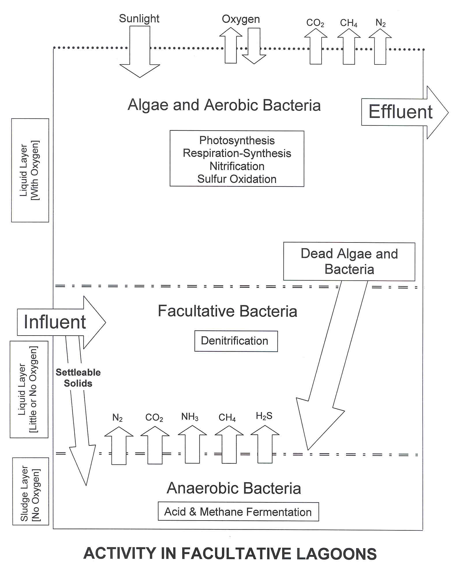
Algae and Aerobic Bacteria
Effluent
Influent
Facultative Bacteria
Anaerobic Bacteria

Slide 71
FACTORS THAT AFFECT THE TREATMENT PROCESS
Influence of Wind
Adds Oxygen
Increases Mixing
Must Be Controlled
By Minimizing Accumulations
of Material On, In, or Around the Lagoon

Slide 72
FACTORS THAT AFFECT THE TREATMENT PROCESS
Influence of Light
SUN
Photosynthesis
Disinfection
Must Be Controlled
By Minimizing Accumulations
of Material On, In, or Around the Lagoon

Slide 73
FACTORS THAT AFFECT THE TREATMENT PROCESS
Influence of Temperature
Rate of
Bacterial Activity
Growth of Algae
Aerobic
Facultative
Anaerobic
O₂
D.O. Saturation
Must Be Considered

Slide 74
FACTORS THAT AFFECT THE TREATMENT PROCESS
Daily Fluctuations
SUN
Temperature
Dissolved Oxygen
Aerobic
Facultative
Anaerobic
O₂
CO₂
pH
Must Be Considered

Slide 75
SEASONAL VARIATIONS
Summer To Fall
Maximum Algae
And Protozoan
Growth
High Algae Vol.
High D.O.
Low B.O.D.
Alkaline pH
Low NH₃-N
Low Soluble P
No Odors
Maximum
Bacterial
Oxidation
CO₂
Phosphorus
Organic Nitrogen
Light
High Temp
Sludge Layer

Slide 76
SEASONAL VARIATIONS
Winter To Early Spring
Low Algae Vol.
Low D.O.
High B.O.D.
Near pH 7
High NH₃-N
High Soluble P
Possible Odors
Reduced Light
Low Temp
Minimum
Bacterial
Oxidation
Minimum Algae
And Protozoan
Growth
CO₂
Phosphorus
Sludge Layer

Slide 77
SEASONAL VARIATIONS
Spring and Fall
Transition Periods
Optimum for Discharging
Within Permit Limits
High Stream Flows - Dilution
High D.O. - Lagoon and Receiving Stream
Minimal Human Contact

Slide 78
ADVANTAGES of LAGOON SYSTEMS
1. Economical to Construct & Operate.
2. Low Monitoring & Control Requirements.
3. Rapid Recovery from “Shock” Loads.
4. Low Energy & Chemical Usage.
5. Low Mechanical Failure.
6. Minimal Sludge Disposal.
7. Long Life.

Slide 79
DISADVANTAGES of LAGOON SYSTEMS
1. Large Land Usage.
2. Low Control Options.
3. Operations Dependant on Climate.
4. Often High Suspended Solids.
5. Seasonal Odors.
6. Possible Ground Water Contamination.
7. Not Good In High Loading Situations.

Slide 80
RESULTS of PROCESS
Public Health Protected
Pathogens Removed
Environment Protected
Characteristics of Wastewater Changed
End Products Stable
Process Itself Is Not Offensive

Slide 81
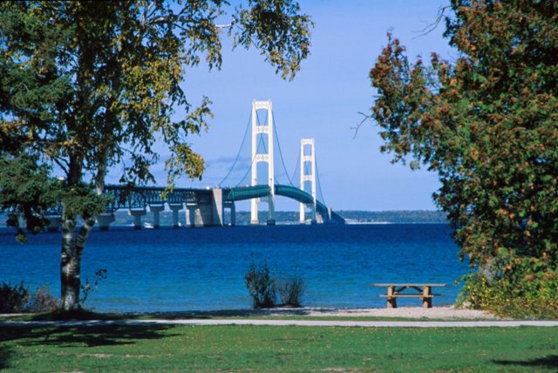
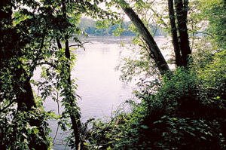
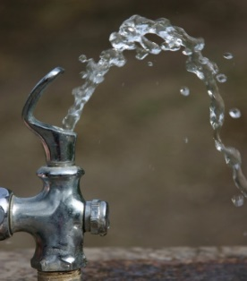
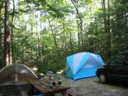

Slide 82
GOOD RESULTS
IF
Process Is In Balance
Properly Designed Facility
Process Is Controlled
System Is Maintained

Slide 83
Waste Stabilization Lagoons
A carefully designed structure
constructed to contain and to
facilitate the operation and
control of a complex process
of treating or stabilizing wastewater.

Slide 84
One Very Important Tool of
Design and Operation
Is The Ability and Use of
Series or Parallel
Flow Through the System

Slide 85
Series
1
2
OR
Parallel
1
2

Slide 86
Typical Lagoon System
#1
#3
X
Influent
Effluent
X
#2
X
SERIES OPERATION

Slide 87
Typical Lagoon System
#1
#3
Influent
Effluent
X
X
#2
PARALLEL OPERATION

Slide 88
Series
1
2
Placing Majority of Load on First Cell
Summer Operation
Parallel
1
2
Dividing Organic Load Between At Least Two Cells
Winter Operation

Slide 89
Loading
Amount Applied
to the
Treatment Process
Related to the SIZE of the System
For Lagoons
Surface Area of the System

Slide 90
Loading
Amount Applied
to the
Treatment Process
Population Loading
Hydraulic Loading
Organic Loading

Slide 91
POPULATION LOADING
Number of Persons per Acre
Population Served (persons)
=
Area of Lagoon (Acres)
General
50 to 500 Persons per Acre
Michigan
100 Persons per Acre

Slide 92
Hydraulic Loading
VOLUME of Wastewater to be Treated
Flow Rate
Gallons per Day (gpd)
OR
Million Gallons per Day (MGD)
Inches per Day
Influent Rate (gallons per day)
=
Pond Volume (gallons per inch)

Slide 93
A lagoon have 350 m long, 230 m width, and operating depth 5 m.
Find surface area of median depth
350 m x 230 m = 80,500 m2
Calculate operating volume in m3
80,500 m2 x 5 m = 402,500 m3
convert into litre (1m3 = 1000 L) so become 402,500,000 L
Calculate litre per metre of depth
402,500,000 L / 5 m = 80,500,000 L/m
How many metres would the water drop if 2.35x10^3 m3 were discharged?
2350 m3 -> 2,350,000 L
2,350,000 L / (80,500,000 L/m) =0.291 m

Slide 94
A lagoon have 350 m long, 230 m width, and operating depth 5 m.
Calculate litre per metre of depth
402,500,000 L / 5 m = 80,500,000 L/m
How many metres would the water drop if 2.35x10^3 m3 were discharged?
2350 m3 -> 2,350,000 L
2,350,000 L / (80,500,000 L/m) =0.291 m

